Slide 1

‘Code without coding’
PixoPoint web development http://pixopoint.com/

Slide 2
Coding for noob developers
HTML/CSS is difficult
Noob code has lots of errors
HTML/CSS -> WordPress != easy
Noob developers need to create WordPress themes without knowing HTML/CSS and PHP/MySQL
Cross-browser dropdown menus → total nightmare
PixoPoint web development http://pixopoint.com/

Slide 3

Dropdown Menus in WordPress
Miriam Schwab of http://wordpressgarage.com/ posted about a dropdown menu plugin
Two choices
  Whine about it
  Make my own
PixoPoint web development http://pixopoint.com/

Slide 4

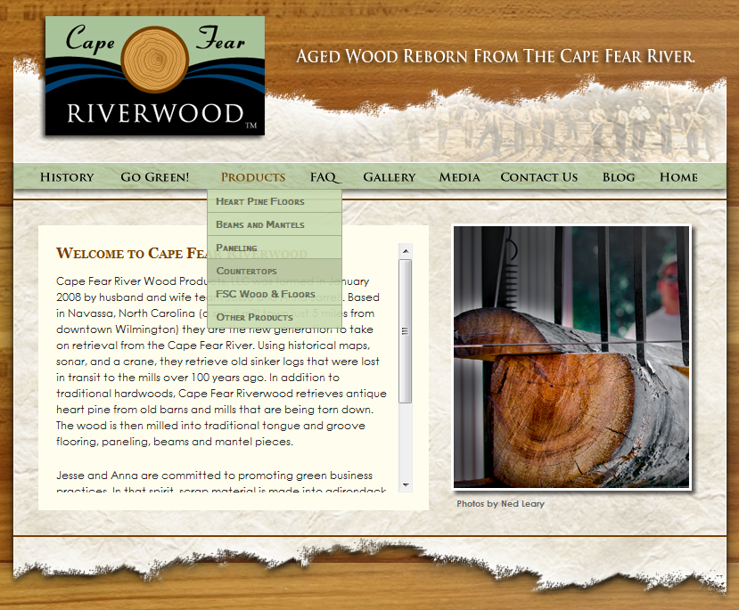

Suckerfish Dropdown Menu plugin
Released in Jan. 2008
Very basic plugin
Support questions!
1000+ comments on
one post in a month!
PixoPoint web development http://pixopoint.com/

Slide 5
Needed a better way to help plugin users
Users needed to modify CSS to change design
Created a forum to help sort advice for others
  Still received too many questions
Needed way to reduce the support requests
  Added option panel to beta plugin for users to modify colours
  Using options panel -> problems
Solution?
  Created CSS generator
PixoPoint web development http://pixopoint.com/

Slide 6
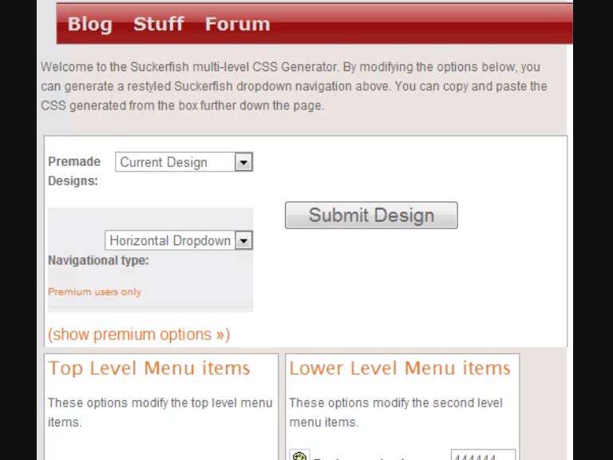
CSS generator
Hosted on PixoPoint.com
  Allows us to charge for
  premium access
  Almost all services free
  100% GPL compatible
Added options page for
copying CSS to plugin
Support requests plummeted!!!
  500+ questions/week -> ~50
Fee for premium support
PixoPoint web development http://pixopoint.com/

Slide 7

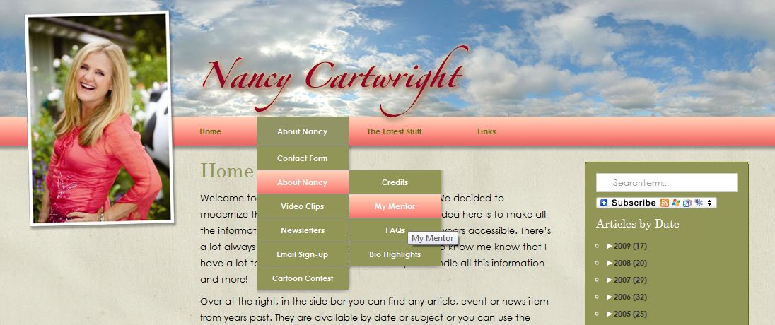
Famous Users of our
CSS Generator
John McCain
Nancy Cartwright (Bart Simpson)
PixoPoint web development http://pixopoint.com/

Slide 8

Themes ... beyond an options page
Our dropdown menu system was a success
The same principle can be applied to an entire theme
Massive complications
  Cross-browser themes are simple to make
  Extending to a template generator → not so simple!
Took 4 months off from
PhD in chemistry
  CSS framework
  WordPress Theme framework
  Editing panel
PixoPoint web development http://pixopoint.com/

Slide 9
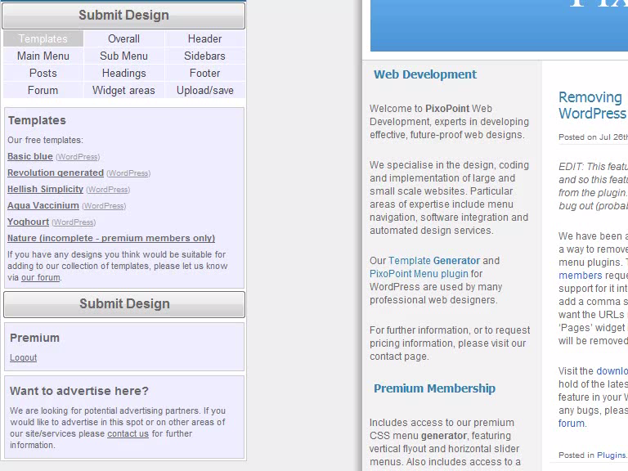
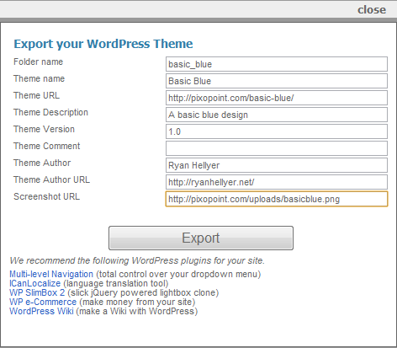
PixoPoint Template Generator Editing Panel
Editing Panel
  Huge array of options
  Ability to control almost all major
  layout/styling attributes
  Styling AND functionality changes
  bbPress forum styling
  Export buttons
PixoPoint web development http://pixopoint.com/

Slide 10
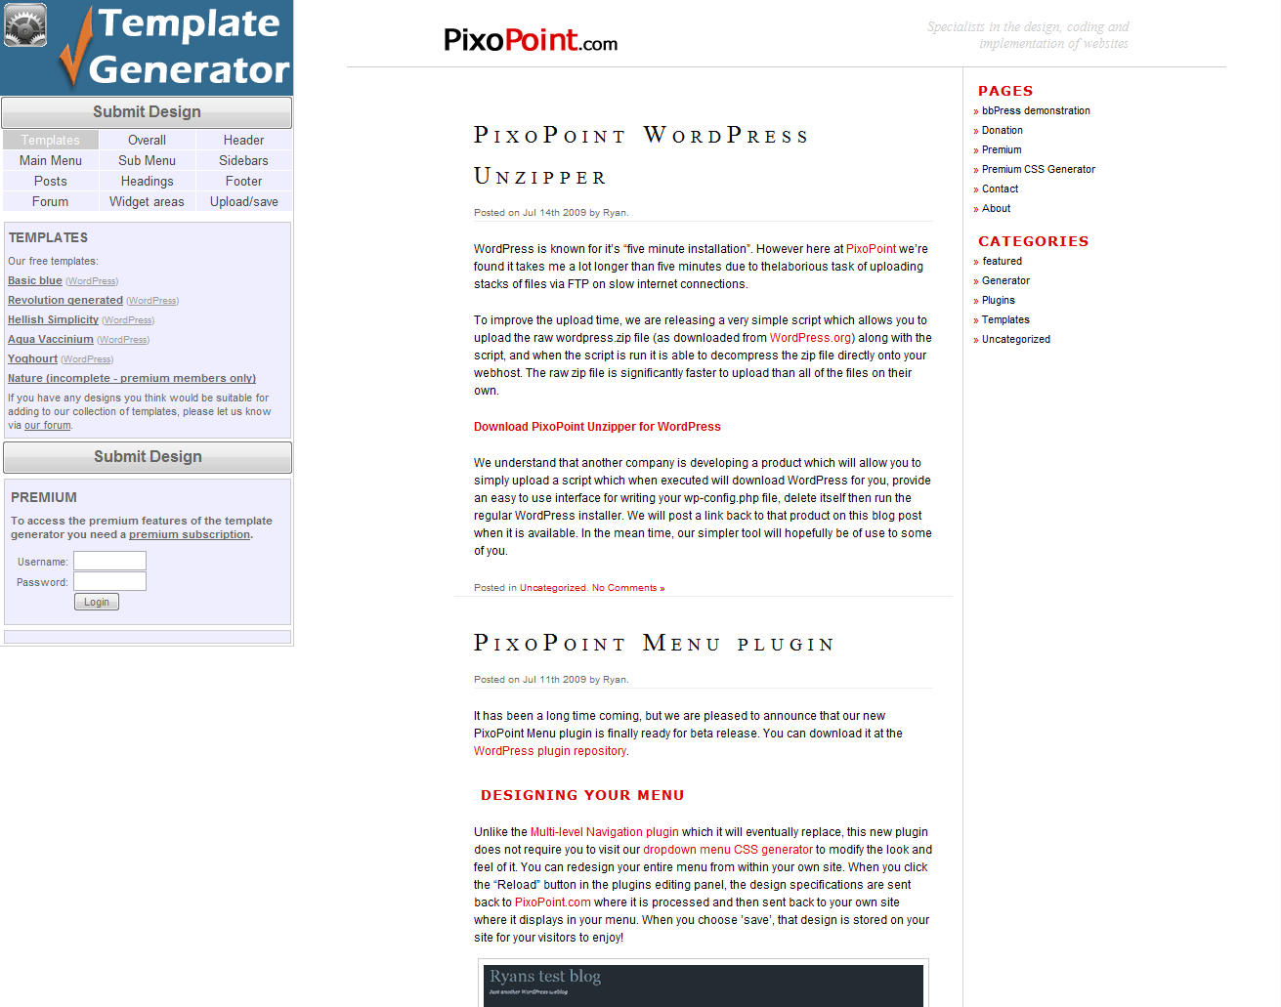
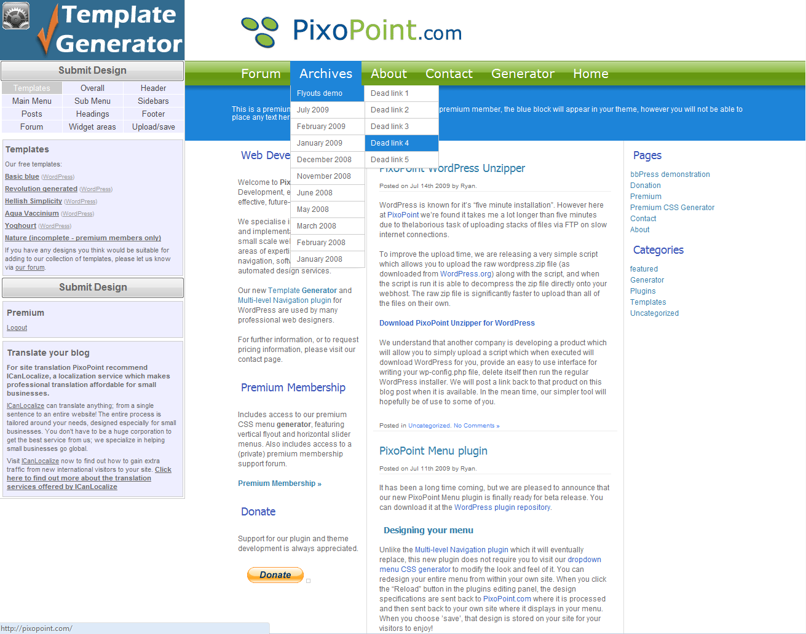
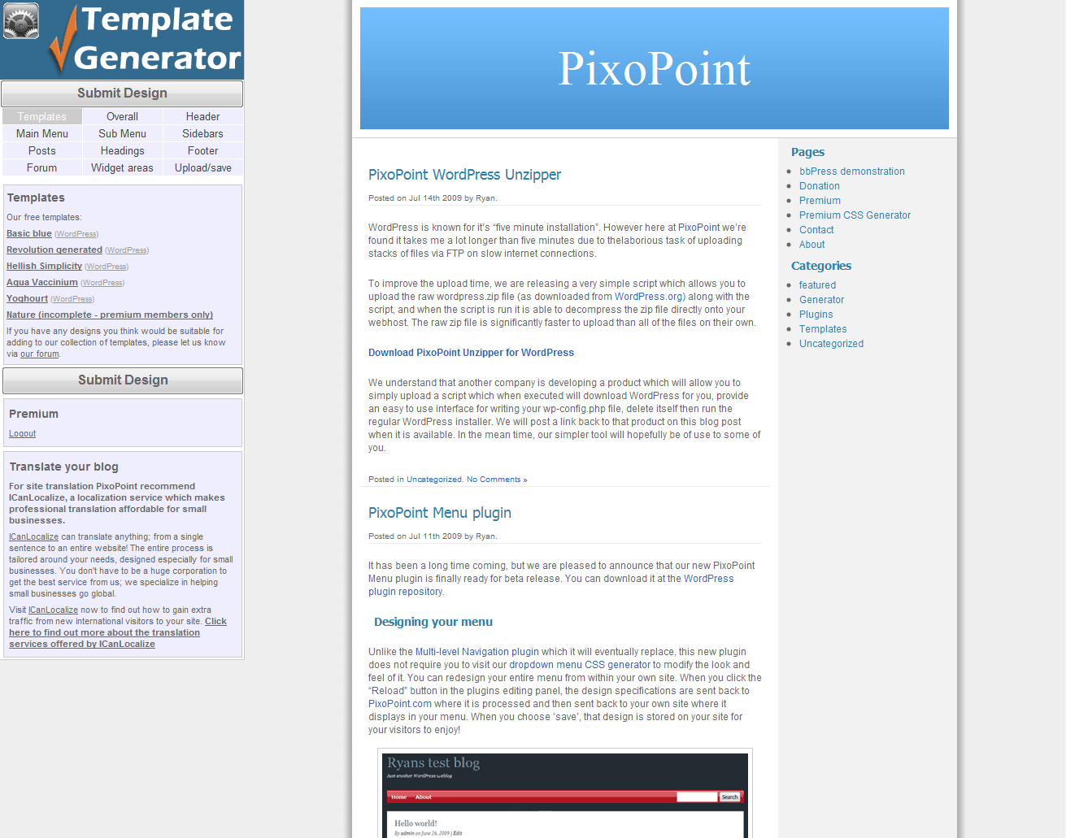
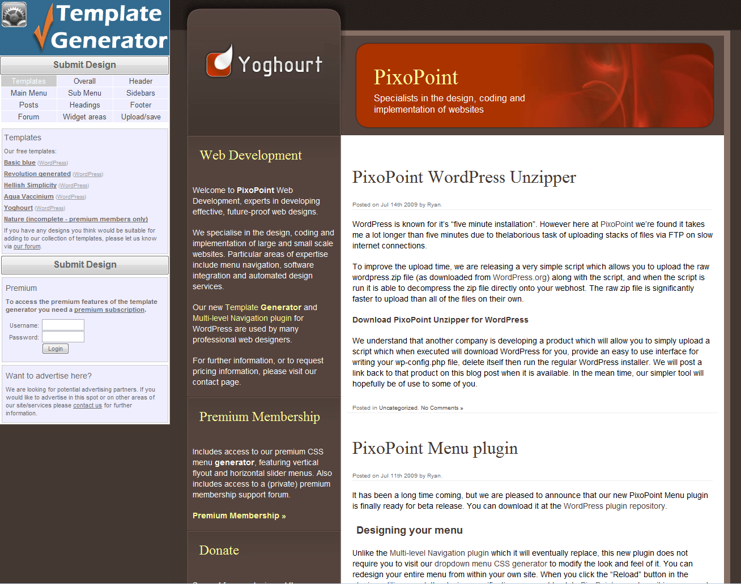
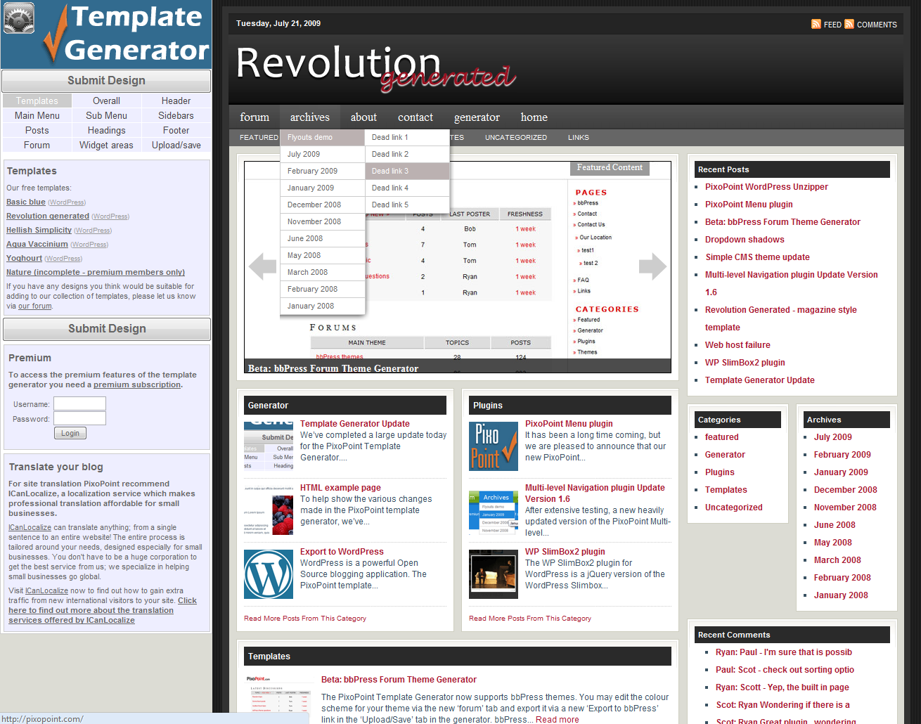

Slide 11
Example sites
PixoPoint web development http://pixopoint.com/

Slide 12
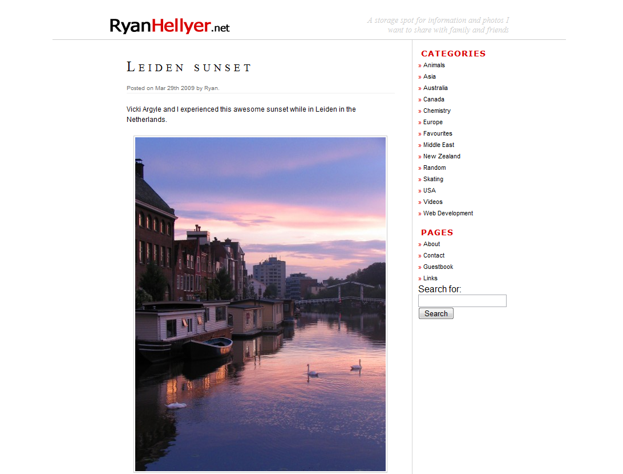

Slide 13


Slide 14
Problems Encountered
Closed source
  Bug fixing very difficult
  Dynamically generated themes → “usually” works fine
Editing panel
  Poor user interface
  Users need to ‘figure it out’ first
Only supports WordPress properly
  Originally intended to support SMF, SilverStripe, Drupal, phpBB and bbPress
  Due to structural errors, adding support for new systems was very difficult
The solution?
PixoPoint web development http://pixopoint.com/

Slide 15


Test Bed - PixoPoint Menu plugin
Features required for new template generator tested on a smaller scale in new menu plugin
WebLogToolsCollection.com plugin competition provided a perfect way to test out new ideas
Good motivation to get it completed on time ☺
PixoPoint web development http://pixopoint.com/

Slide 16
PixoPoint Menu Plugin – Editing Panel
Users wanted to edit their menu on their own site
Originally needed to use PixoPoint.com to get CSS
New plugin places editing panel on the users site
Plugin sends data back to PixoPoint.com for processing
CSS is sent back to users site, where it is stored in their WP database
Demo ...
PixoPoint web development http://pixopoint.com/

Slide 17
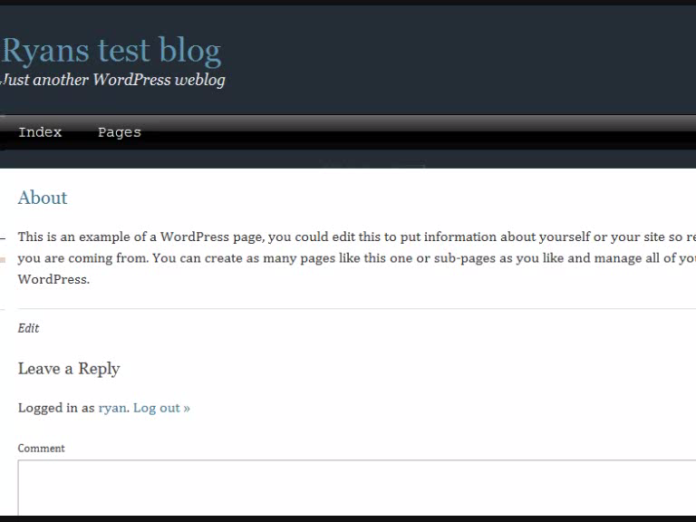
PixoPoint Menu plugin – Demo
Users wanted easier way to control menu arrangement
  Widget style drag and drop
Pulldown menus
Some settings in tab
PixoPoint web development http://pixopoint.com/

Slide 18
Back to the Template Generator ...
How does the plugin help the template generator?
There will only be one “theme”
  available on WordPress.org
  built in editing panel
  Options will be sent to PixoPoint.com for processing
  PixoPoint.com will send CSS back for storage in the WP database
WordPress Mu compatible

Slide 19

Open Sourcing Advantages
Core of template generator will
become open source
Open source allows for:
  Users submitted patches (time saver)
  Can ask questions in public (ie: help forums)
Crowd sourcing of editing panel
Only need to maintain one theme
Conclusion ...
PixoPoint web development http://pixopoint.com/

Slide 20
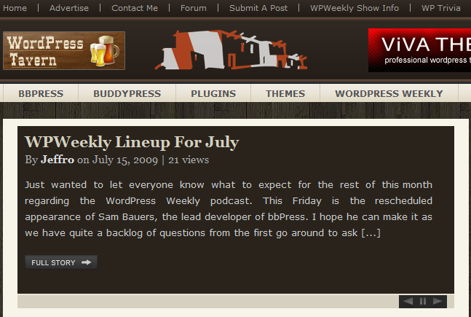
Thanks for listening ☺
The Brooker Bunch
Greg Yingling (transientmonkey.com)
Paul O’Brien (pmob.co.uk)
Dan Milward (instinct.co.nz)
Jeff Chandler (wptavern.com)
SitePoint staff (sitepoint.com/forums/)
For more info.
  http://ryanhellyer.net/
  http://pixopoint.com/
PixoPoint web development http://pixopoint.com/

