Slide 1
WP Paintbrush
WordPress for those who hate writing code

Slide 2
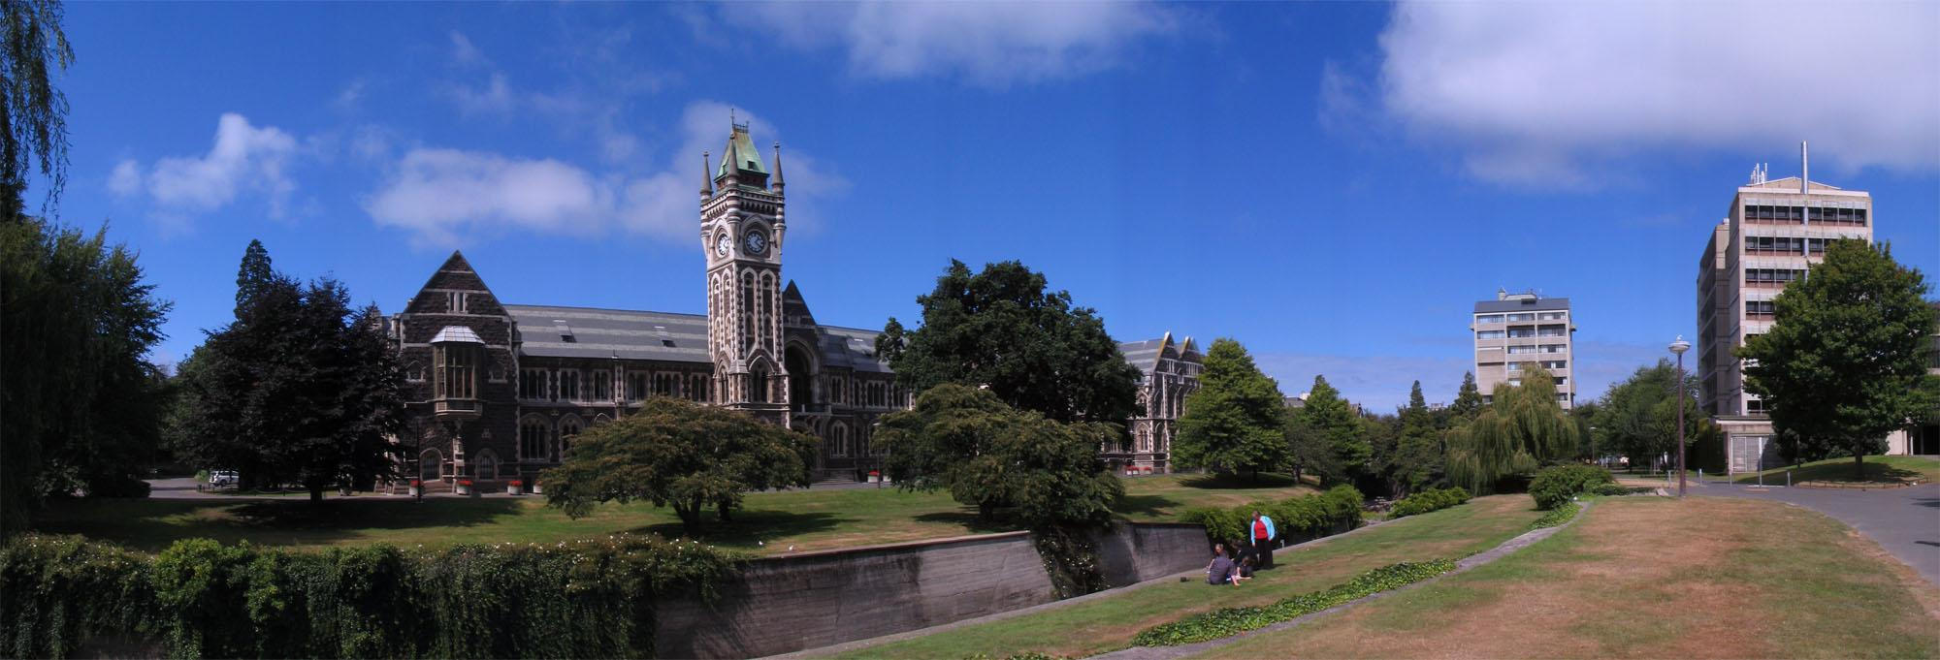
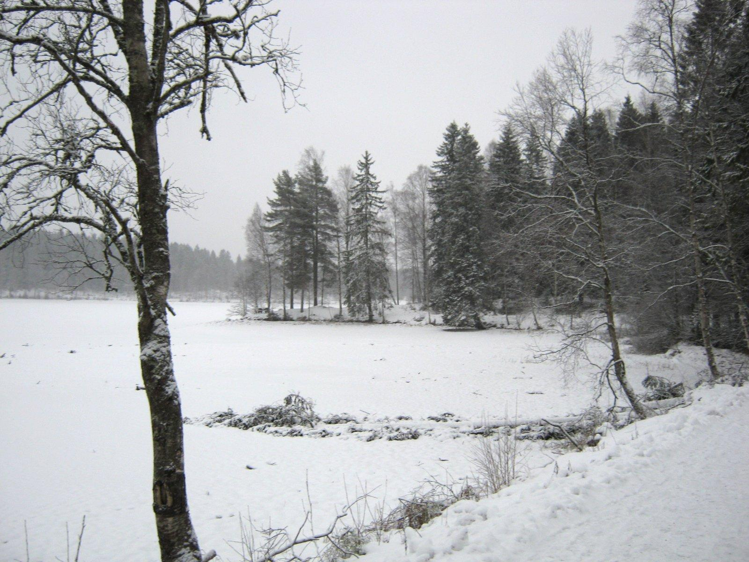
From New Zealand -> Norway
PixoPoint -> Metronet

Slide 3
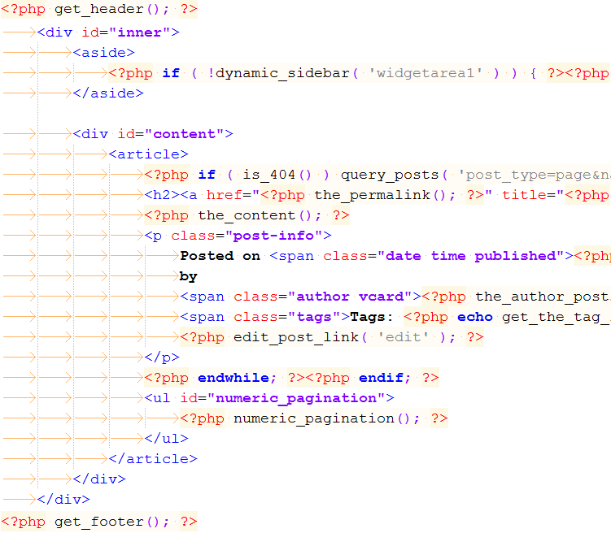
WordPress theming
Easy for some
Too time consuming for some
Impossible for others
Requires writing code
HTML, CSS, JavaScript
Very basic PHP
There must be a simpler way ...

Slide 4




Off the shelf designs
Extremely popular
Multi-million dollar industry
Licensing

Slide 5
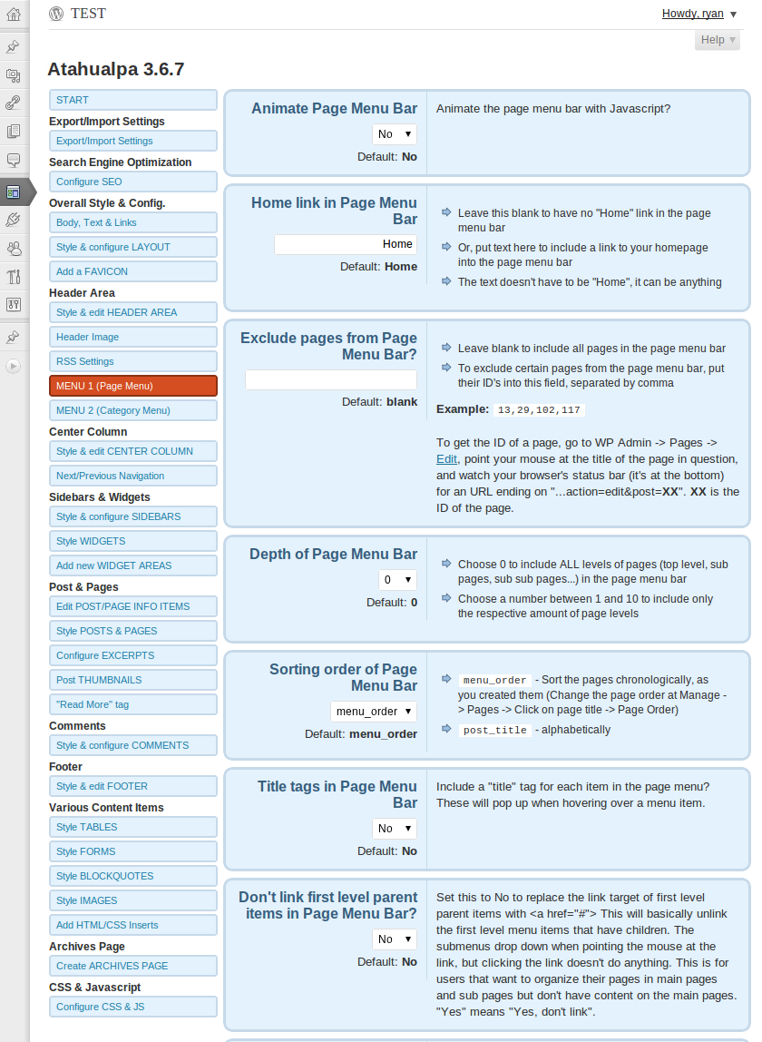
Theme Options
Design via admin panel
Can't see changes immediately
Poor UI/UX
Popular despite flaws

Slide 6
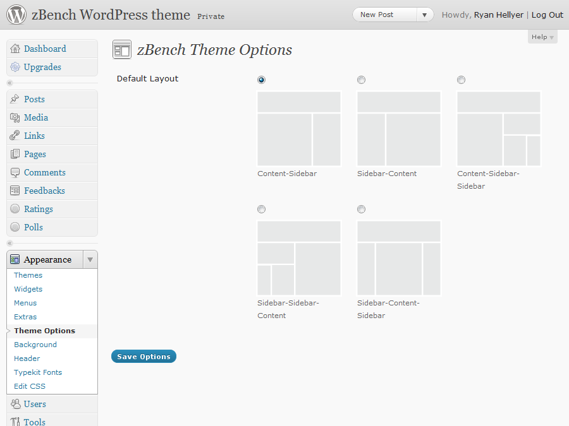
Basic Layout Editors

Slide 7

Solution?
Front-end editor
Drag and drop
Colour pickers
Image pickers
Font selectors
AJAX goodness!
Progress?

Slide 8
Demo
Live demonstration ...
Coraline > Magazine

Slide 9
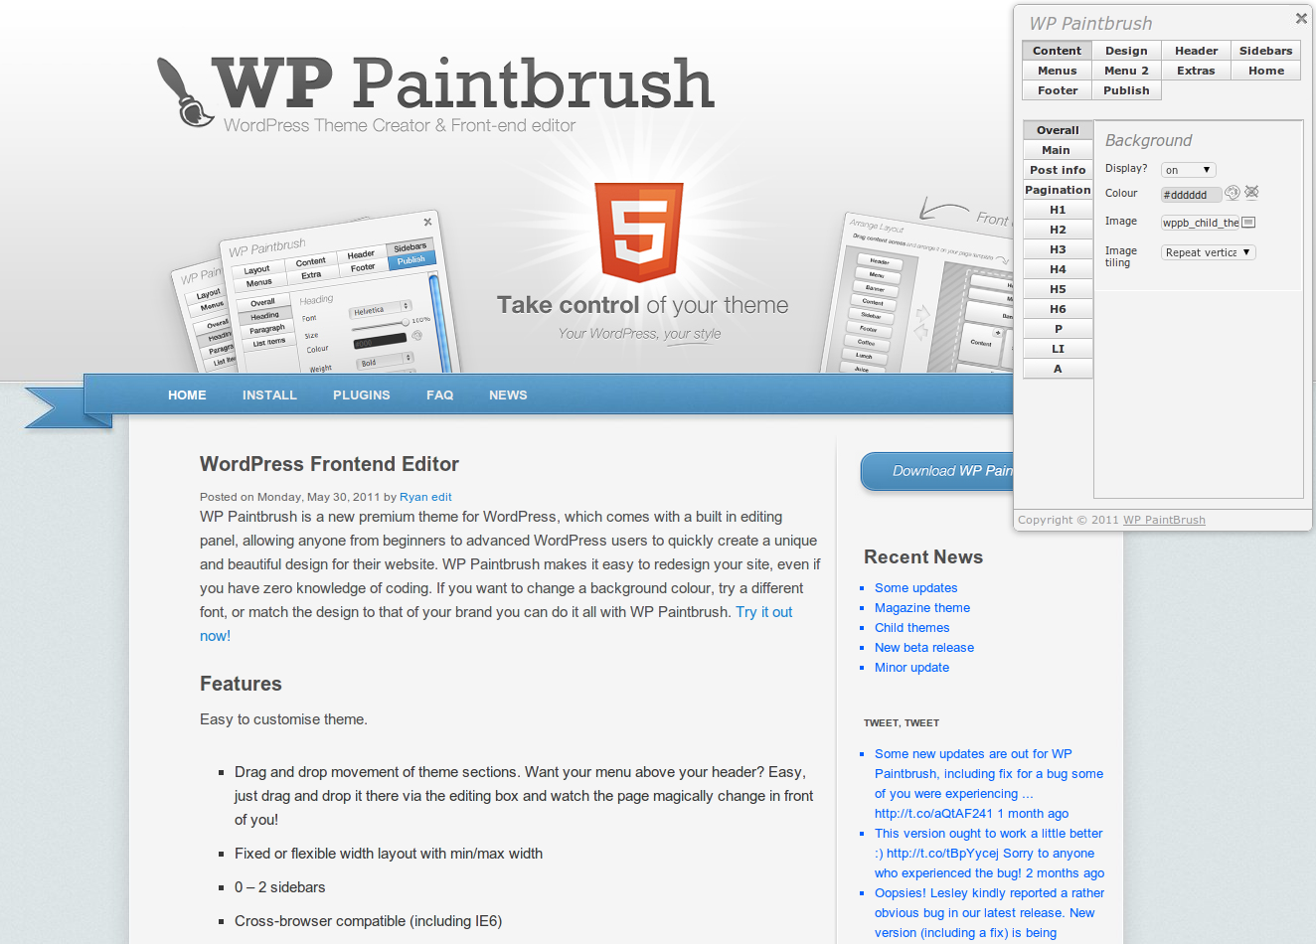
http://wppaintbrush.com/

Slide 10
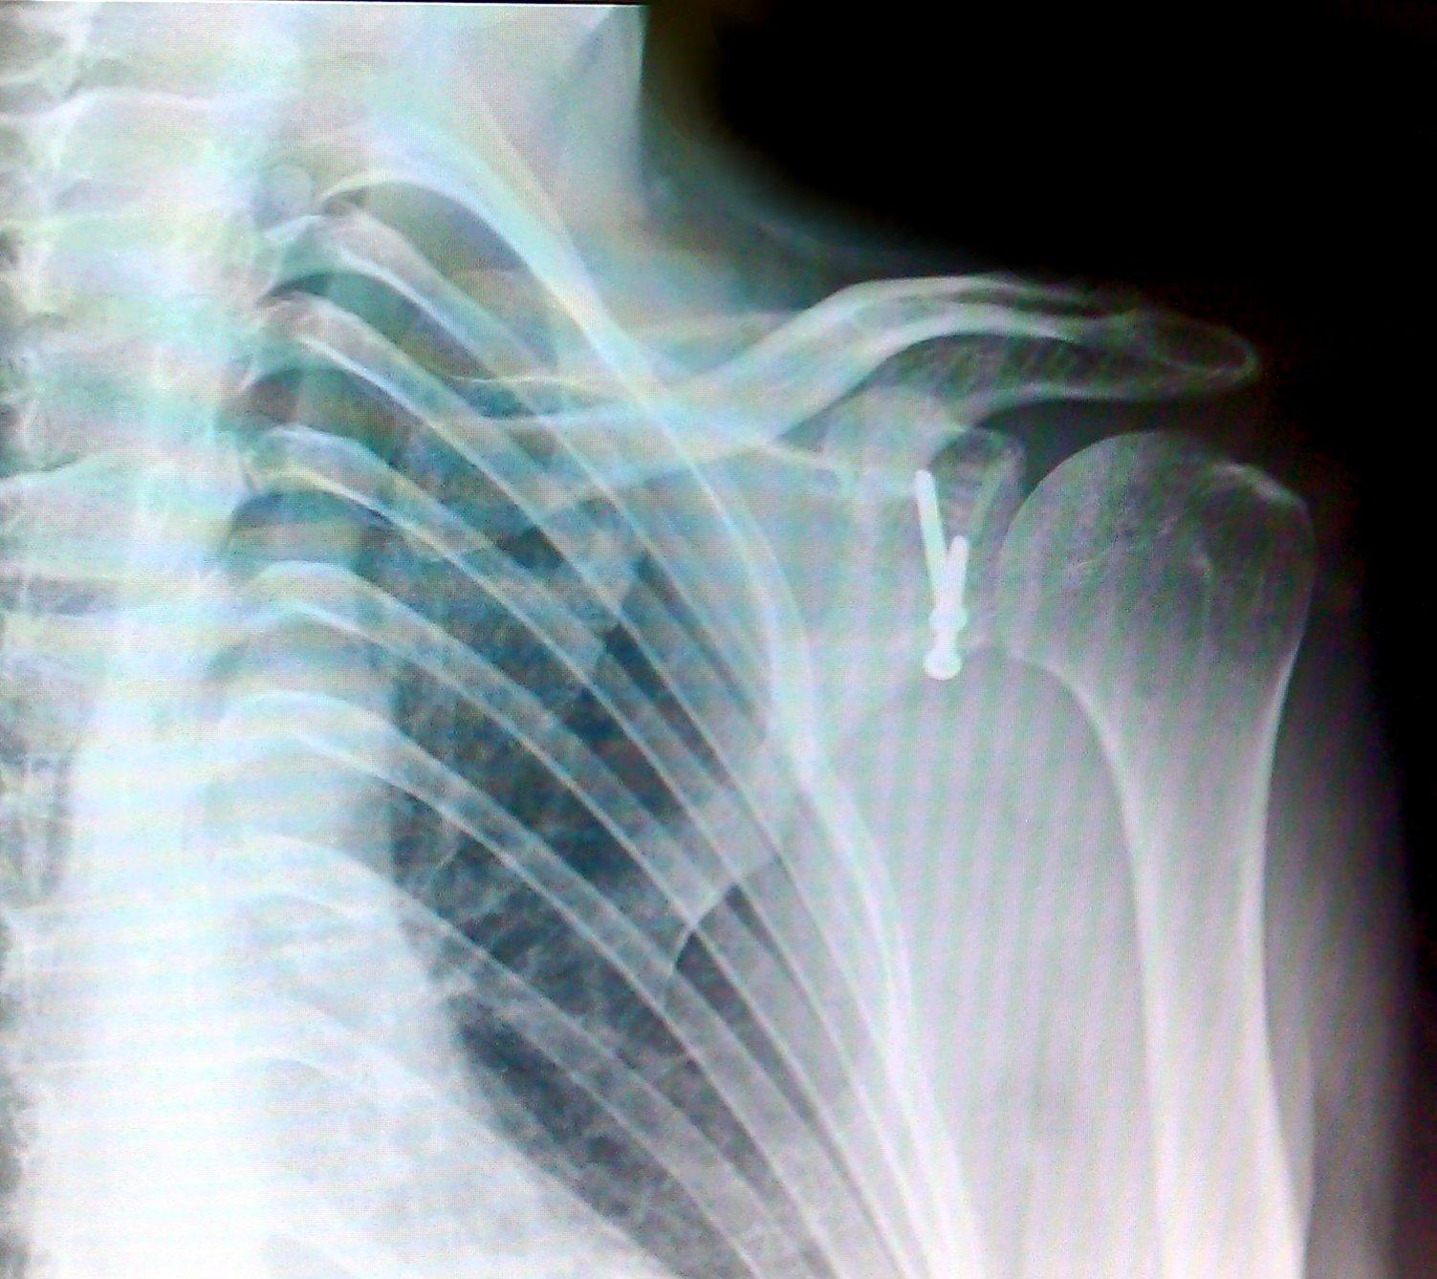
Delays ....

Slide 11

WordPress Installation
Easy for some
Difficult for some
Impossible for others
Hosting - shared, VPS, dedicated ...
PHP
MySQL
cPanel
There must be a solution ...

Slide 12

Hosted Solutions
Blog.com, WordPress.com
Can choose existing themes
Can only edit CSS
Very limiting
Free :)
Need more control ...

Slide 13

http://pressabl.com/ ... coming soon'ish!
Hosted multisite solution
Ability to upload and edit themes
Security concerns solved
PHP templates; familiar and easy to use ...

Slide 14

Multi-site
Front-end editor works
What if user wants fine grained control?
PHP security issues
Solution?

Slide 15
WordPress themes
WordPress themes
PHP based templates
Very popular system
Still requires code
HTML, CSS, JavaScript
Very basic PHP
PHP -> security issues

Slide 16

PHP = bad

Slide 17
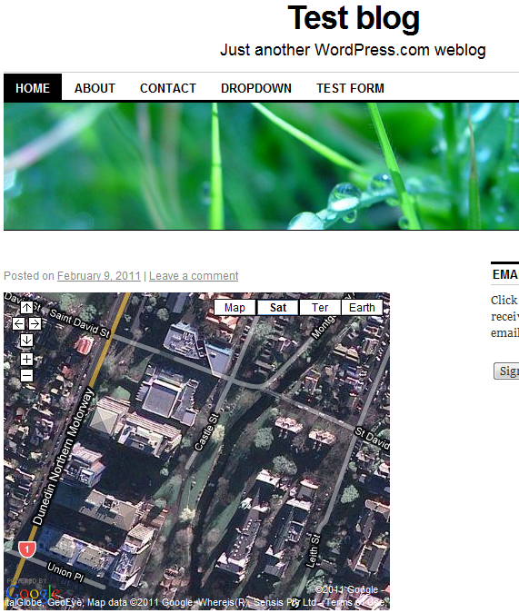
Shortcodes
WordPress shortcodes
Allow users to embed maps, contact forms, polls, videos, galleries, slideshows, audio clips and more
But users still want to edit basic template features
Why not allow it? ...

Slide 18
PHP templates
Easy to use
Lots of documentation
Extremely flexible
Massive security risk

Slide 19
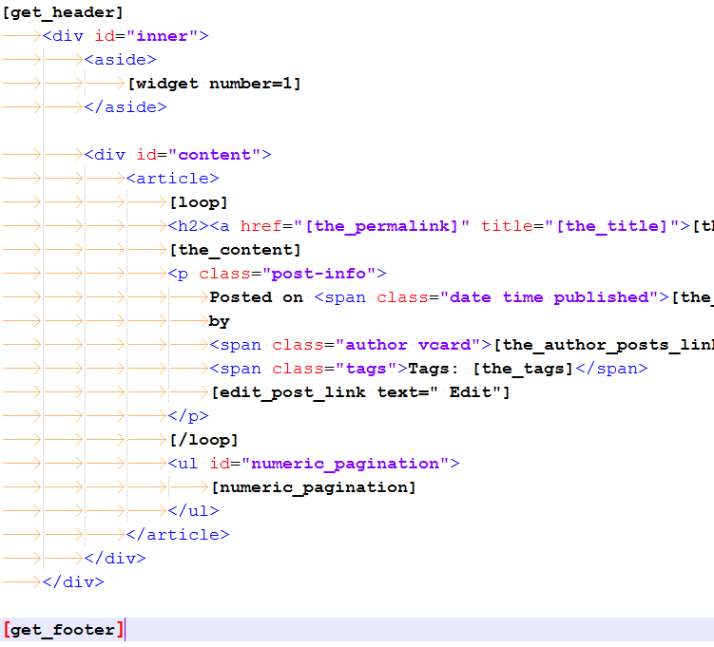
Shortcodes
75+ new shortcodes
<php the_content(); ?>
[the_content]
[loop]
<h2>[the_title]</h2>
[the_content]
[/loop]

Slide 20
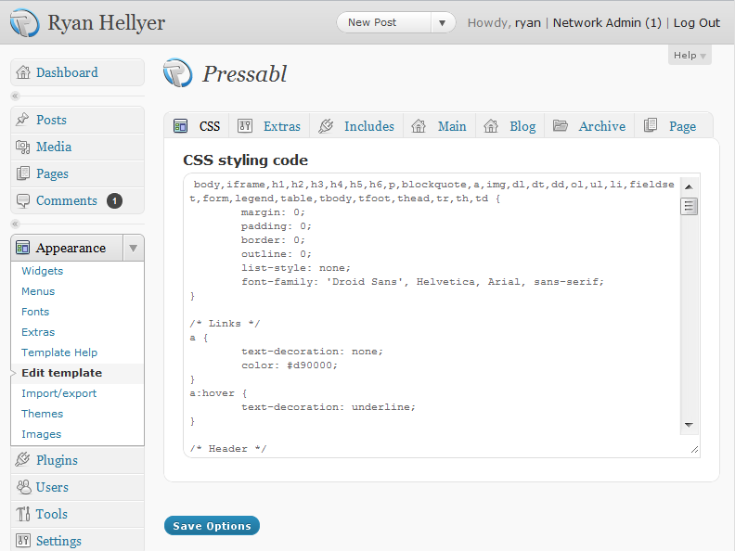
Templates
Utilize same theming system as traditional WordPress themes
page.php
index.php
single.php
style.css

Slide 21
Demonstration
The template editor

Slide 22
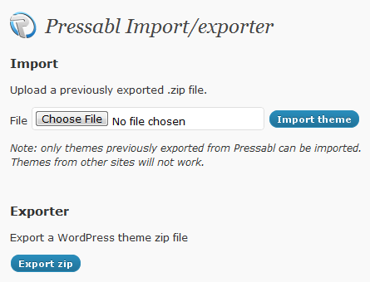
Importing/exporting Themes
Exported as child theme
Uploading raw PHP
Huge security risk!
Solution :)
Data file in child theme

Slide 23
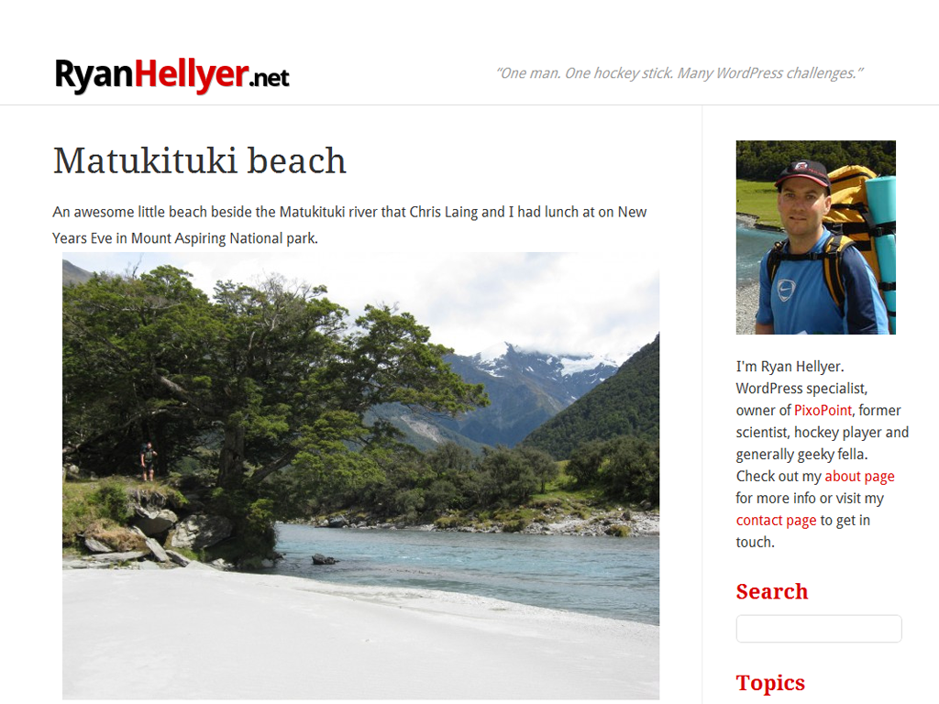
Example: ryanhellyer.net

Slide 24
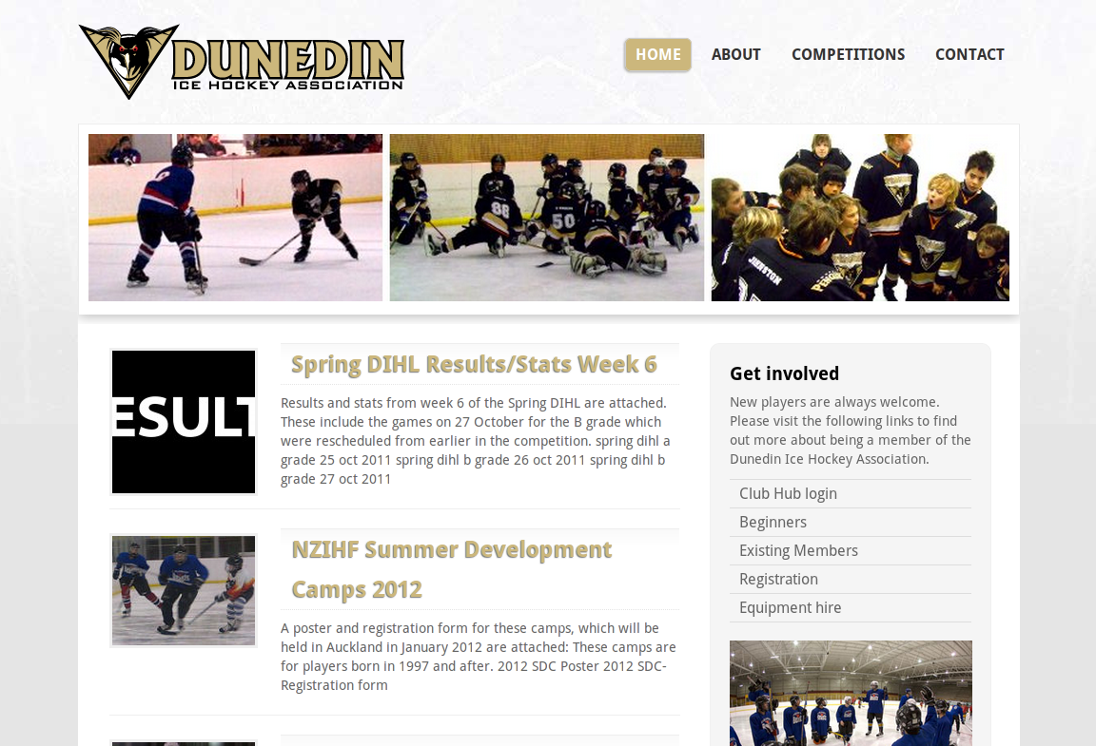
Example: dunedinicehockey.co.nz

Slide 25





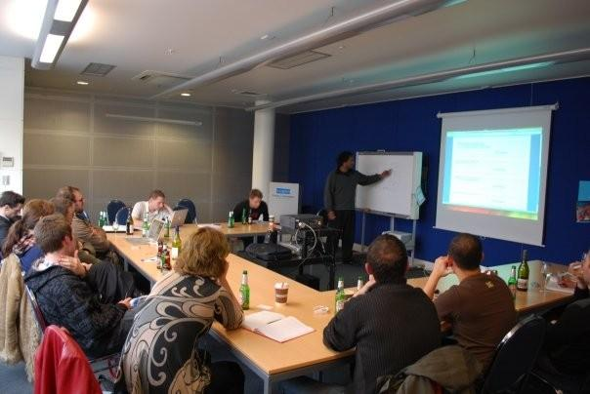
Credits
Dan Milward
(New Zealand)
Alex Cragg
(UK)
Ronald Huereca
(USA / Norway)
Utkarsh Kukreti
(India)
Distiller
(New Zealand)
David Thornycroft
(New Zealand)

