Slide 1

Security
It’s not paranoia when they’re actually out to get you!

Slide 2
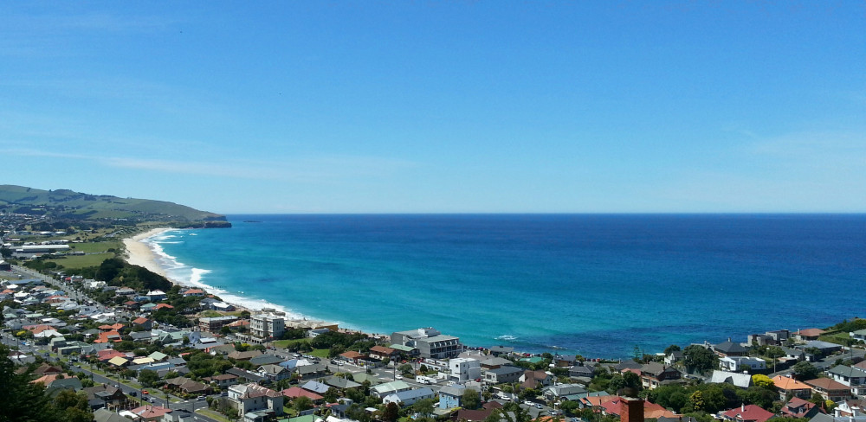
Where in the world is Ryan from?
Notes:
Used to live in NZ … Made plugins for fun …

Slide 3
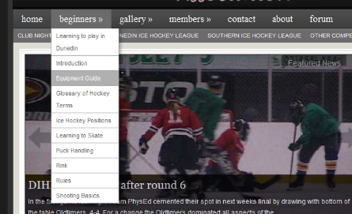
Created a menu plugin
Pre menus in core
Dropdowns!
Notes:
Miriam’s post … Made simple plugin … made more complicated plugin … made really complicated plugin!

Slide 4

John McCain
Notes:
Outsourced to Arizona company, outsourced to California company, outsourced to New Zealand :) … Presidential website … asked for discount … multiplied price by factor of 4

Slide 5
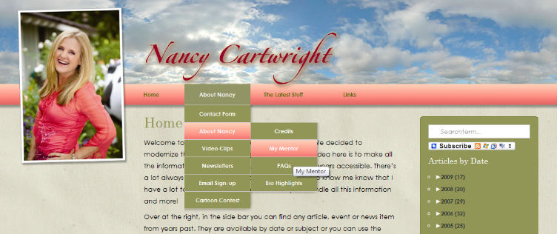
Bart Simpson
Notes:
Bart Simpson

Slide 6

Security audit
A+
No flaws found

Slide 7

Disaster
Blog post
Security flaw found
Public announcement
update_option( ‘css’, $_POST[‘css’]
Notes:
Some douch w

Slide 8
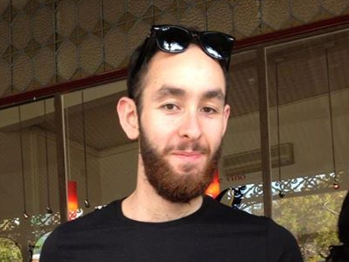

Slide 9

Notes:
Fix … Learn, learn, learn … Realise almost no one understands security … plugin repo. a disaster

Slide 10
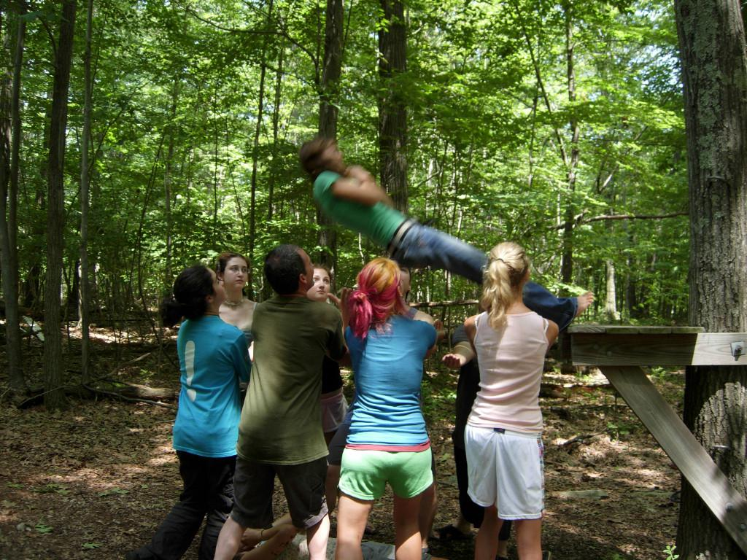
Trust no one!

Slide 11


Slide 12
Code injection
Trusted users … no problem
Trusted user accounts … big problem
Code injection via admins is a big problem
XSS

Slide 13

Nerdy interlude

Slide 14
Need to do four things …
Check user has permission
Check user intended to do it
Sanitize/validate user data
Escape data before output

Slide 15
How to spot bad code
Impossible to teach in a short lecture :(
update_option( ‘bla’, $_GET[‘test’] );
echo get_option( ‘bla’ );
http://domain.com/?test=<script>alert(‘test’);</script>

Slide 16
Trusting outside sources
$_SERVER
$_COOKIE
$_POST
$_GET
$_REQUEST
API data

Slide 17
The rules
Trust no one
  Including logged in users
Validate/sanitize inputs
Escape outputs

Slide 18
Top 100 plugins on WordPress.org
In 2011, found (hackable) security flaws in 50%
  20% were hackable on most setups
In 2014, most have been fixed
  Still need to be careful of elevated permission setups
Quality has gone up for the top 100 plugins :)

Slide 19
WordPress security plugins
Securi Security plugin
Core file verification check!
Minimum Password Strength plugin

Slide 20
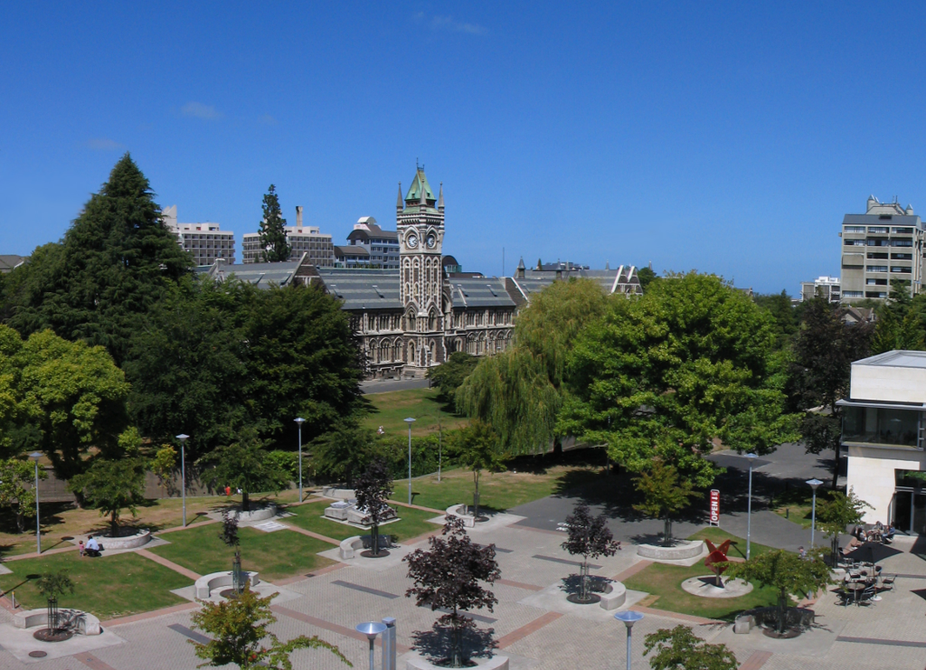
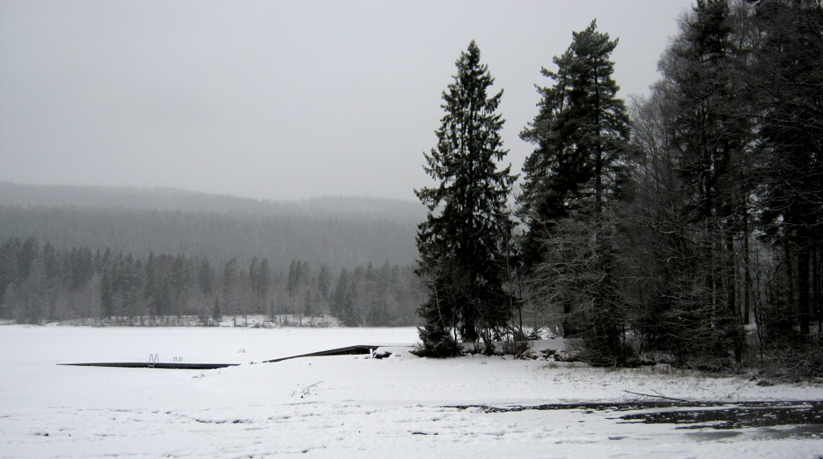
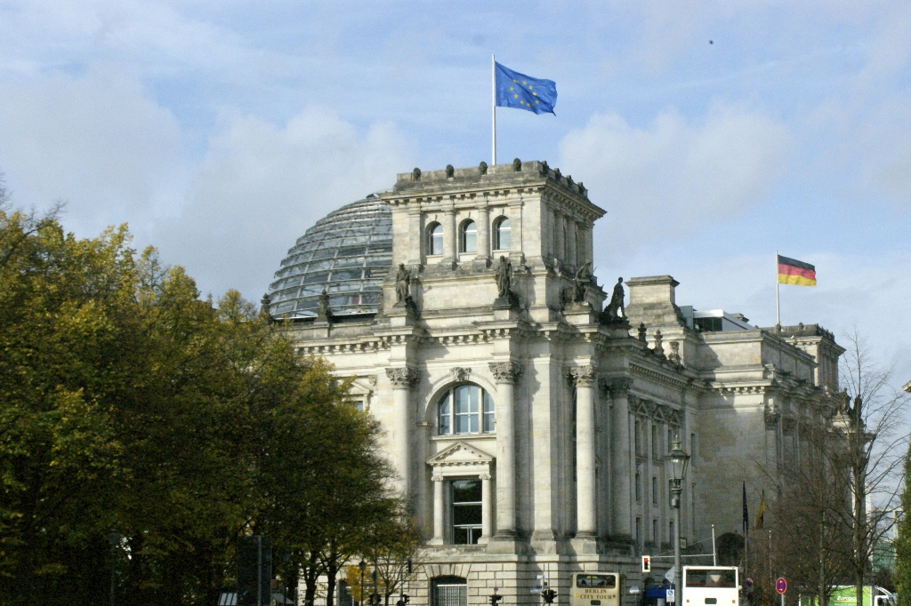
New Zealand
Norway
Germany

Slide 21

Lets put our tinfoil hat on

Slide 22
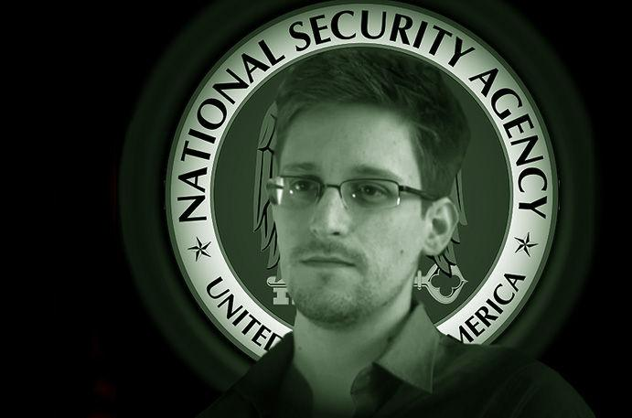
Notes:
After Snowden, lots of people are paranoid about security

Slide 23
Scenario
Want to store private data in our website
Only certain people to have access
Use private pages?
User password protected pages?
Something better?
Notes:
Next step, how do we store data securely in WordPress?

Slide 24
Encrypt data
Can’t send unencrypted data back to the server
Browser -> [encryption] -> server -> browser -> [decryption]

Slide 25
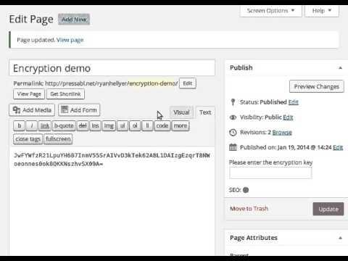

Slide 26
Problems
Similar to CryptoCat
Self JavaScript attack
Solution?
  browser plugin
Help wanted!

Slide 27
Thank you!
10up
Anthony Cole
Mark Jaquith

