Slide 1
Speed is key
How and why to use caching on your website
Notes:
But handling load most important
Extra load = slower speed

Slide 2
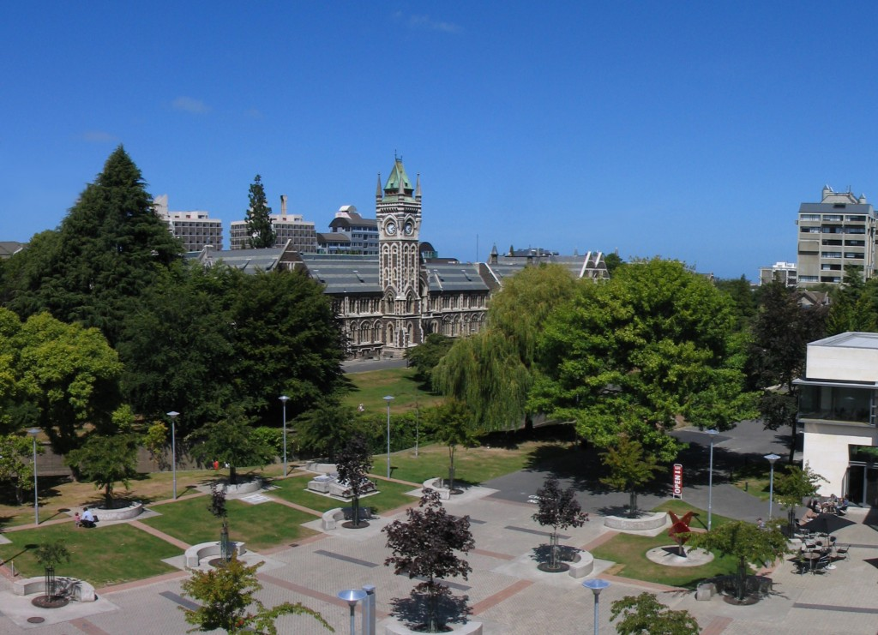
Land of the worlds crappiest internet!

Slide 3

Notes:
1 TB data transfer/month = 10 million page views/month
$10/mnth
->
Managed VPS - no caching - seemed fine

Slide 4
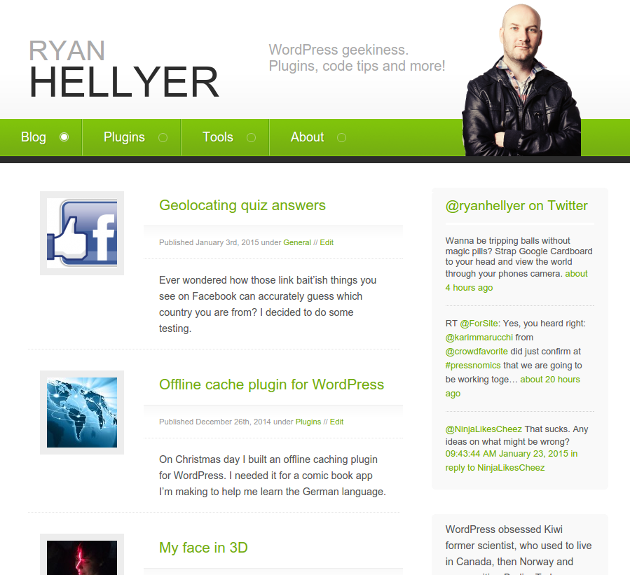

Slide 5

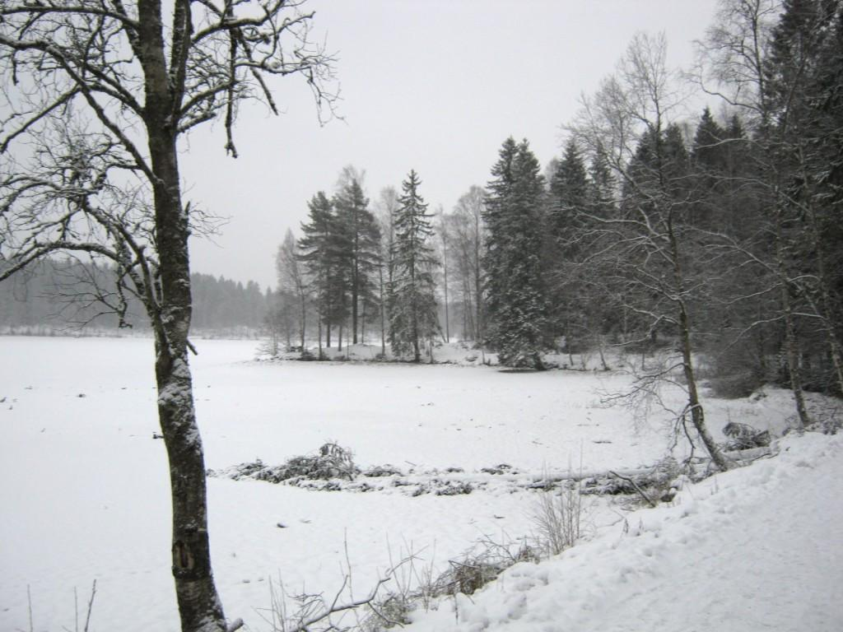
Move to Norway

Slide 6

Notes:
Realised lack of caching was a problem
~5 page views/sec via ApacheBench

Slide 7
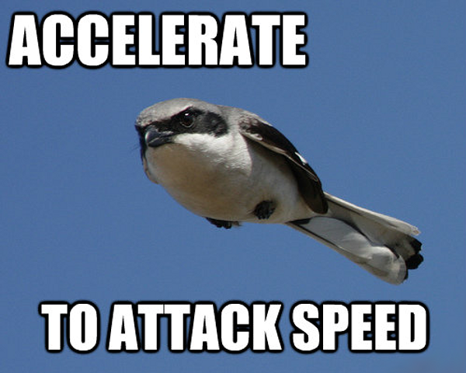

Slide 8

Static caching

Slide 9
Use faster software
Nginx?
HHVM?

Slide 10




Notes:
Managed hosts
Static caching
Needs more knowledge than most people realise

Slide 11
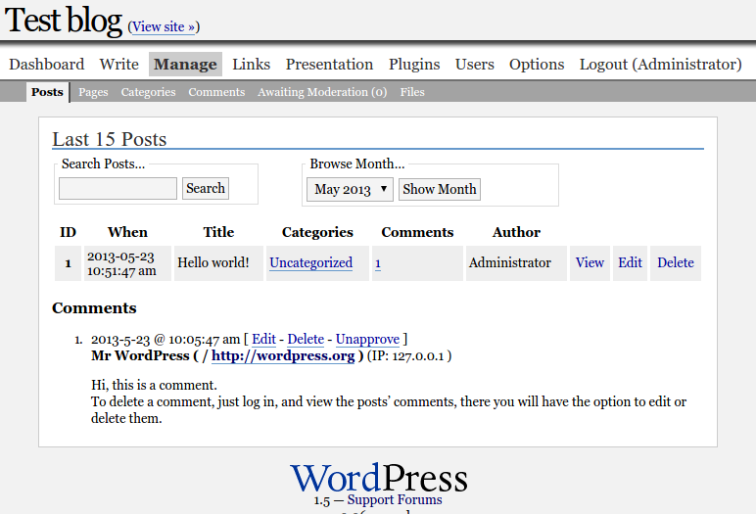
https://geek.hellyer.kiwi/tools/historic-wordpress/
Notes:
Make application do less
Work = time
Smaller app = faster app

Slide 12

~40,000 registered
users in one day
Notes:
Less pages = easier to cache

Slide 13


Slide 14
Persistent object caching
wp-content/object-cache.php
Query count … ~20 -> ~4
Notes:
Discuss WP cache API

Slide 15

Object caching backends
In memory cache
  Memcached
  APC
  Redis

Slide 16


Slide 18



Caching your bits
Widgets
https://github.com/kasparsd/widget-output-cache
Fragment caching plugin
https://github.com/Rarst/fragment-cache
Menus
https://geek.hellyer.kiwi/plugins/menu-cache/

Slide 19
Extra steps
Use external services for dynamic stuff
Disqus comments
Spam protection
https://geek.hellyer.kiwi/plugins/spam-destroyer/
Fail2Ban
SPDY protocol
Block wp-login.php
Offline caching
https://geek.hellyer.kiwi/plugins/offline-cache-plugin/
Weed out bad plugins
https://github.com/Rarst/laps
https://wpperformanceprofiler.interconnectit.com/
Notes:
Multilingual plugins

Slide 20
Measuring page speed
Pingdom
Google Page Speed
Yahoo! YSlow
GT Metrix
Caching has almost no effect on these.
Measure individual page speed instead of ability to handle traffic.

Slide 21
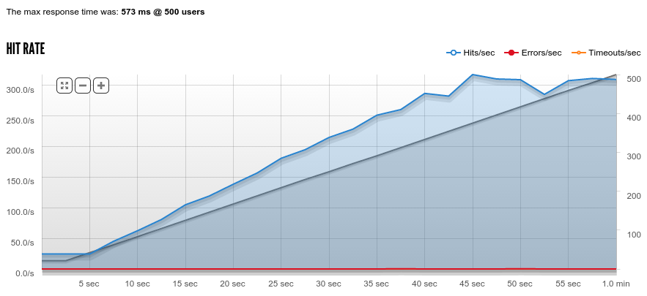
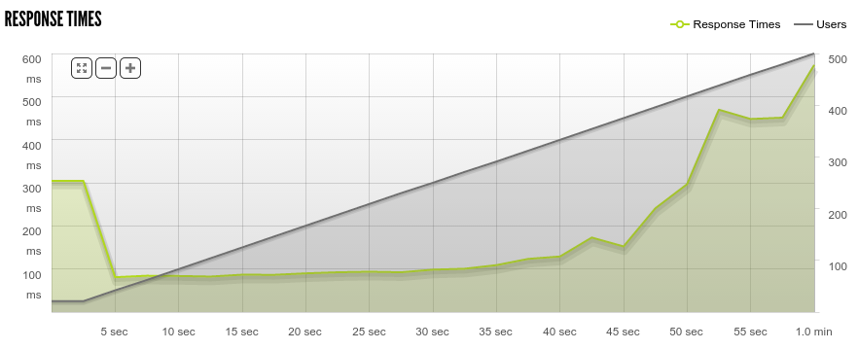
Measuring ability to handle load
Apache Bench
Siege
Blitz.io

Slide 22

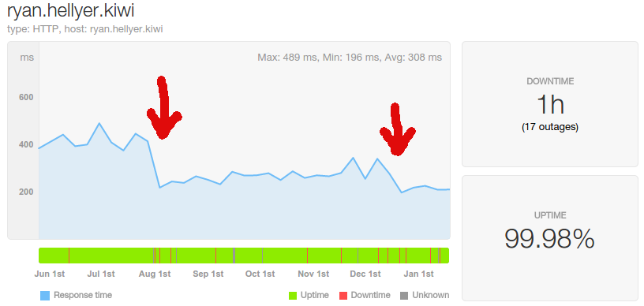
Performance monitoring over time
Notes:
1 = APC out of RAM
2 = Halved RAM. Added https. Used Nginx static cache and Redis.
Swedish company.
Outages due to stupidity.

Slide 23

reverse proxy
“Website Offline, No Cached Version Available”

Slide 24
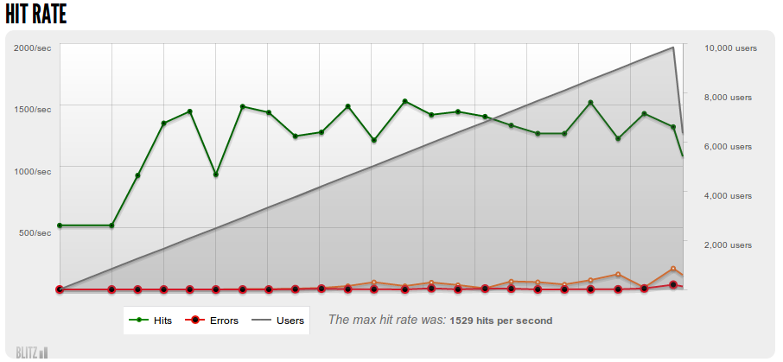
CDN all the things!
1500 page views per second
Initial page loads within 6 ms!!!!

Slide 25
Take home message …
Caching is hard

Slide 26

https://geek.hellyer.kiwi/presentations/
@ryanhellyer

