Slide 1
Tortoise vs the hare
High performance WordPress hosting on the cheap

Slide 2


Slide 3

My original setup
Slow internet connection
Multiple Hostgator shared accounts
  Cost ~US$9 / month each
  Got kicked off service

Slide 4


An upgrade ...
Fully managed VPS
  1 GB RAM
  Immediate speed boost
  Hardware failure
  Failed backup

Slide 5


Move to Norway

Slide 6

Move to Norway
Depressing to visit my own site ...

Slide 7


Solution?
Managed WordPress host?

Slide 8


Unmanaged VPS
Tried to setup
Failed
Tried again
Tried again
Gave up :(
Solution?

Slide 9

Stubbornness
Hire expert :)
Learn from expert :)

Slide 10
Back to Linode :)
US$20/month
Half the RAM of old server
Minimal setup
  NGINX
  PHP
  Fast-cgi or PHP-FPM?
  APC

Slide 11

APC and Batcache
Avoid bloated caching plugins
Batcache plugin
  Lean, mean
APC plugin
Hacking advanced-cache.php
  Mobile support

Slide 12

CDN
Content Delivery Network
Ideal for static files
Used custom plugin
Alternatively ... WP Stack by Mark Jaquith

Slide 13

Result
100/100 possible?

Slide 14

Varnish caching?

Slide 15

blitz.io
Load testing service
http://blitz.io/
Test with 50,000
concurrent users

Slide 16
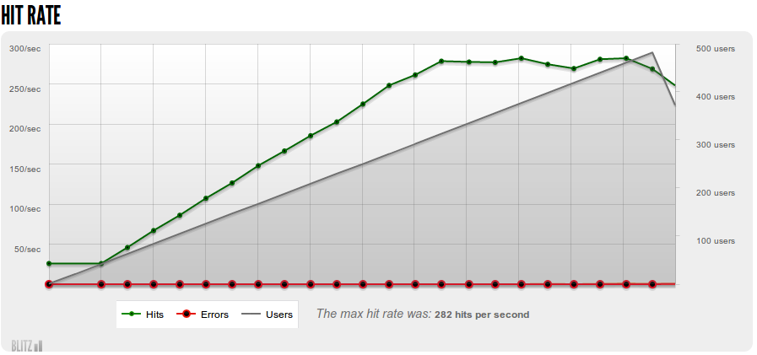
How much traffic?
ryanhellyer.net: ~270 page views per second, max load time = 700 ms

Slide 17
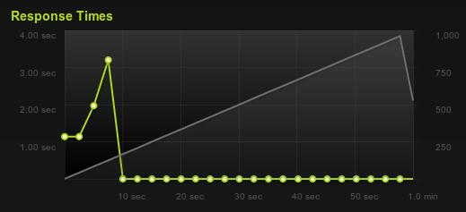
Old and new comparison
Old: 29 page views per minute (server locked up under initial load)
New: 270 page views per second

Slide 18
Will Varnish allow more traffic?
Bandwidth at 282 page views per second = ~54 Mbps
Maximum bandwidth on Linode tested = ~60 Mbps max.
Varnish would offer little increase in capacity
Potential decrease in load time

Slide 19
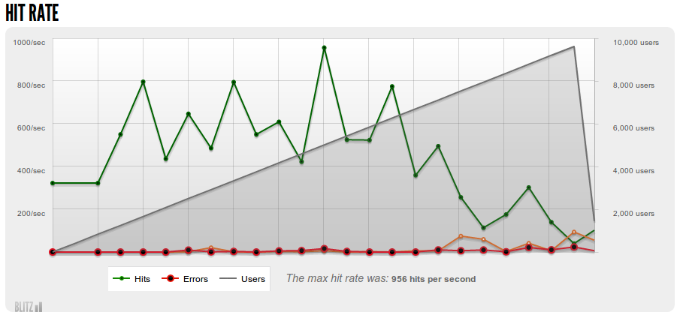
Lean HTML?
konstruktors.com = ~700 page views per second

Slide 20

MOAARRR power!!!

Slide 21
Already using the solution!
Pointing your primary domain
at cloudfront will not work
Doesn't support $_POST
  wp-admin will fail
  comments will fail

Slide 22
How to avoid breaking site
Seperate front and
back domains
http://cloudfront.ryanhellyer.net/
http://clouddemo.ryanhellyer.net/

Slide 23
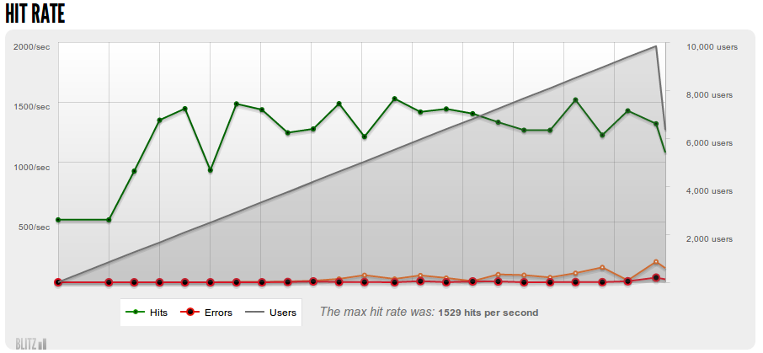
Performance?
1500 page views per second
Initial page loads within 6 ms!!!!

Slide 24

Comments?
Set low Cloudfront expiry time
Submit comments form to other domain
  Redirect user back to same page, with query var
Disquis

Slide 25
Advantages to Cloudfront
Crazy fast load times ... 6 ms
Serves files from edge location
Massive capacity
Extremely cost-effective

Slide 26

Ultimate test?
Botnet attack
Mission accomplished

