Slide 1




Slide 2
Metronet Plugins
Why we make them and why you should too!

Slide 3

Short on Metronet
Based in Oslo, Norway 30+ people
●
Started as a search company, evolved into an IT-company
●
Medium-sized + projects (250 hours +)
●
Websites
○
Campaign sites / social media applications
○
Intranet
○
E-commerce
○
*
Metronet

Slide 4

















Web team
*
Metronet

Slide 5
Why do we do Open Source?
Open Source is usually cheaper for the client.
●
Same development cost.
○
No license costs (More money for value added).
○
Open Source lets us utilize the work of awesome people like you.
●
The business opportunity is massive.
●
Few competitors specialized in Open Source.
○
Often several competitors offering the same licensed solution and
○
fighting over the client.
*
Metronet

Slide 6
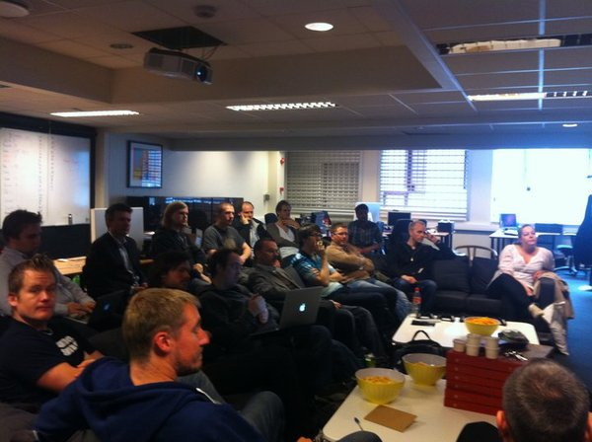
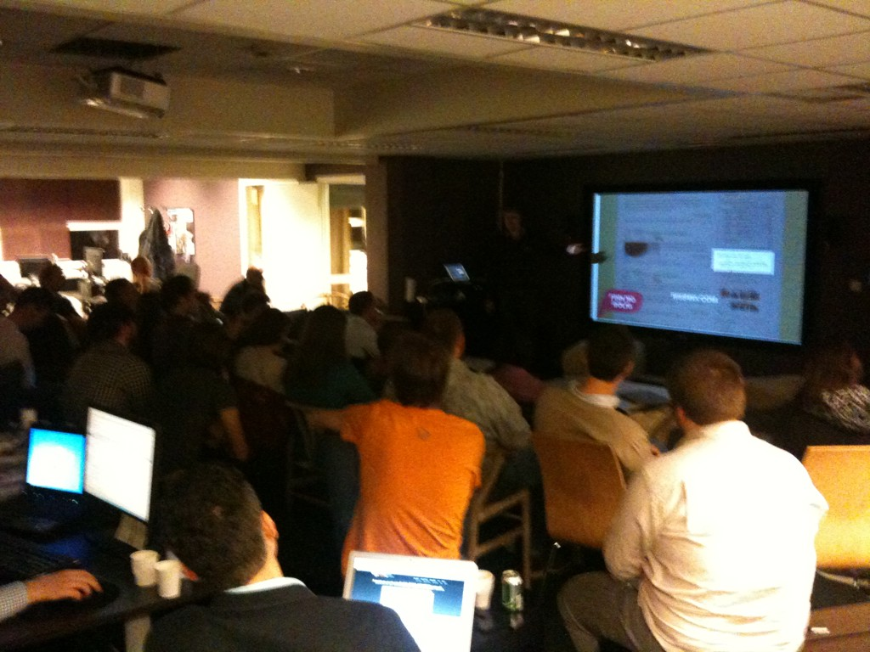
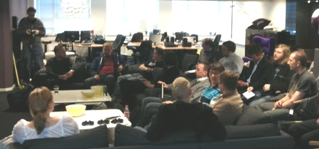
WordPress in Oslo
●WordCamp Oslo 2013
(probably in January)
●WordPress meetups each
month
*
Metronet

Slide 7
Why the community is important
to us?
More people talking WordPress to businesses paves the ground for
●
higher market penetration for WordPress.
The community is a great army of ambassadors.
●
We can only do so much.
●
We hand of projects to other companies when we feel we are not
○
the right vendor.
The community is smarter than us
●
We stand on the shoulders of giants...
○
Visibility in the community makes it easier to attract both clients and
●
talent.
*
Metronet

Slide 8
So how does this relate to plugins?
If it is useful for us and our clients it is likely it could be useful for
●
other developers.
Releasing plugins is our way of paying back to the community.
●
Some clients also requests us to release plugins.
●
Norwegian Government has paid for the development of three of
○
our plugins.
Good karma
●
*
Metronet

Slide 9
Ryan Hellyer...

Slide 10
My plugin history
Pre 2012
●Made plugins for myself
●Made plugins that interested me
2012
●Make plugins that others request
●If we need it, presumably other
consultants also need it ...
*
Metronet

Slide 11
Extensibility
Development for developers, not bloggers.

Slide 12


Metronet

Slide 13
Reordering posts
Commonly required feature which we previously customised into themes

Slide 14

godtlevert.no
*
Metronet

Slide 15

communicate.no
*
Metronet

Slide 16
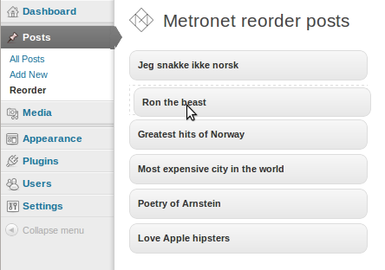
Metronet Reorder Posts
Available from http://wordpress.org/extend/plugins/metronet-reorder-posts/
*
Metronet

Slide 17
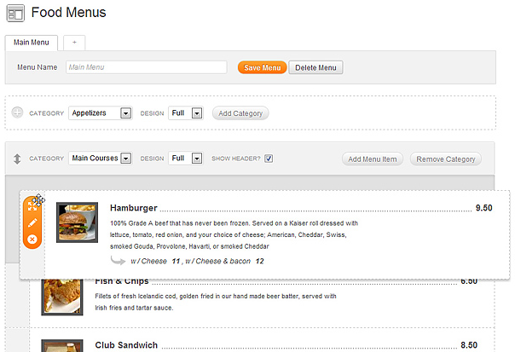
Happy Tables - Noel Tock
Image stolen from http://wcnl12.noeltock.com/
*
Metronet

Slide 18
Metronet Reorder Posts
●Highly extensible
●Abstractable class
●Rons' hierarchical support
●Noel's features coming soon :)
Available from http://wordpress.org/extend/plugins/metronet-reorder-posts/
*
Metronet

Slide 19
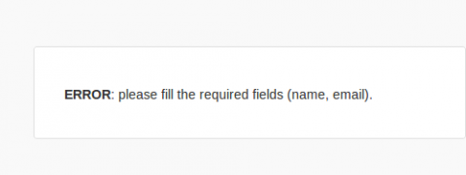
Comment Errors
Norwegian Government requested a fix for this
*
Metronet

Slide 20
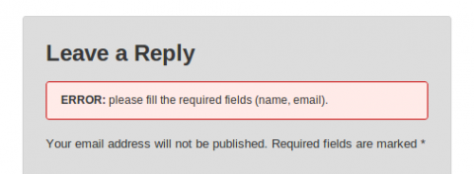
Comment Errors
Available at http://wordpress.org/extend/plugins/comment-errors/
*
Metronet

Slide 21

Comment Errors
Available at http://wordpress.org/extend/plugins/comment-errors/
*
Metronet

Slide 22
Delete Delete Site
Cients deleting their own site = BAD!

Slide 23

Metronet

Slide 24
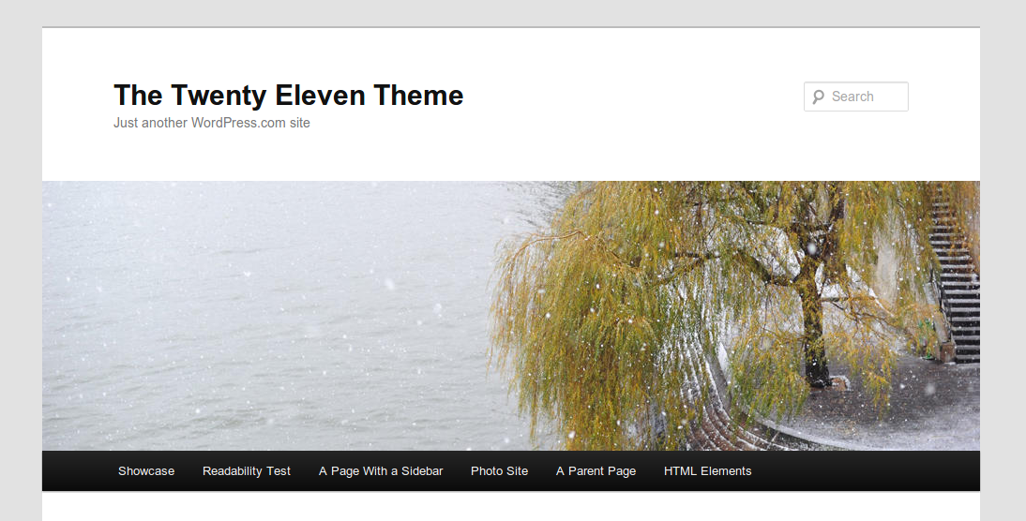
Unique Headers
How to add unique headers for different pages?
*
Metronet

Slide 25

Unique Headers
http://blogg.regjeringen.no/framtidensbarnehage/
*
Metronet

Slide 26
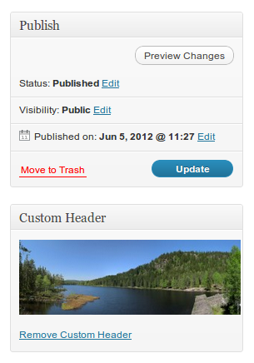
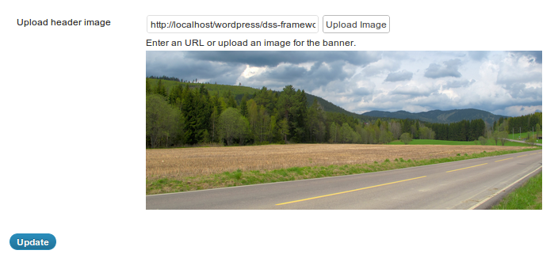
Unique Headers
Available from http://wordpress.org/extend/plugins/unique-headers/
*
Metronet

Slide 27
Custom registration and login system
Commonly required feature on complex sites

Slide 28
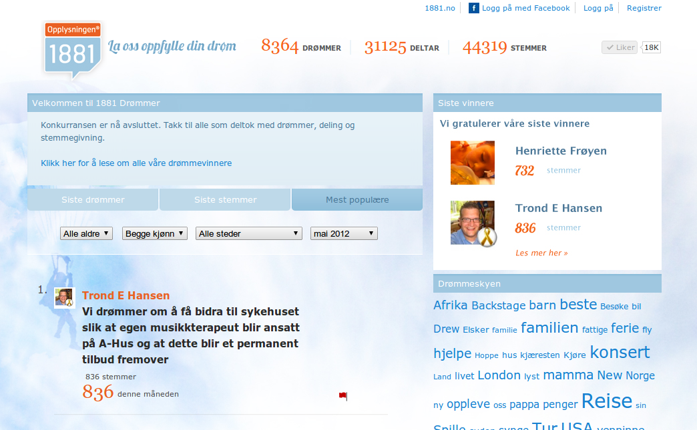
1881.no/drommer
*
Metronet

Slide 29
godtlevert.no
*
Metronet

Slide 30
Custom registration / login plugin
●Needs to:
○be highly extensible
○allow auto-login on registration
○be highly customisable
○Able to integrate with Facebook,
Twitter, Google logins etc.
*
Metronet

Slide 31
Custom registration / login plugin
Flawed approach
●
Outsmarting self
●
Plugin should only contain logic,
●
minimal markup or styling
Need templating layer
●
Watch this space :)
●
*
Metronet

Slide 32
Multi-lingual plugins ........ brutal database queries
Watch this space :)

Slide 33
Come work for Metronet! http://metronet.no/jobb

Slide 34
Thanks for listening
http://metronet.no/
http://arnsteinlarsen.no/
@arnsteinlarsen
http://ryanhellyer.net/
http://pixopoint.com/
@ryanhellyer

