Slide 1
Road to plugin development
https://geek.hellyer.kiwi/ htttps://twitter.com/ryanhellyer/

Slide 2
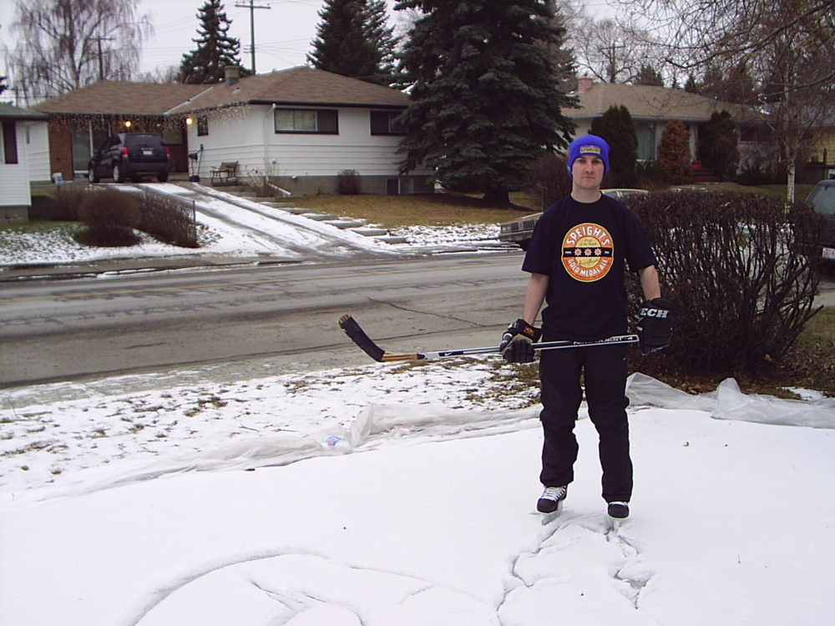
Moved to Canada

Slide 3
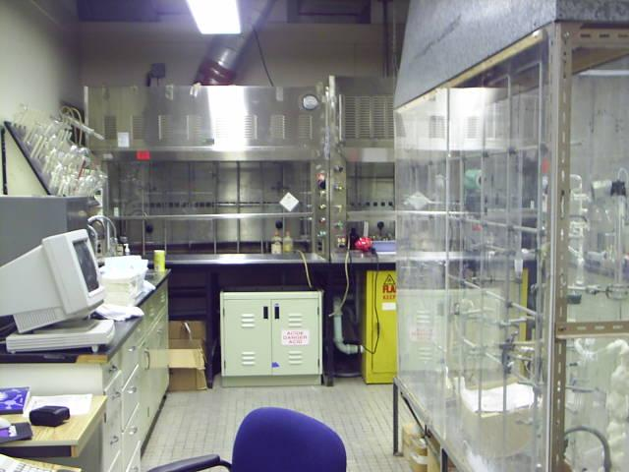

Slide 4
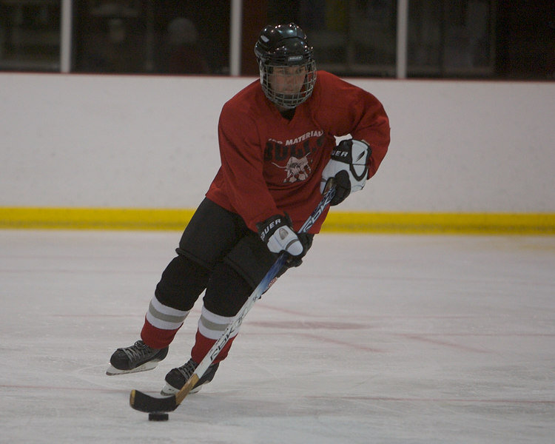
Local ice hockey club - 2006
Impossible to find
out game times
HTML website
PHP (SMF Forum)
2007 - WordPress

Slide 5
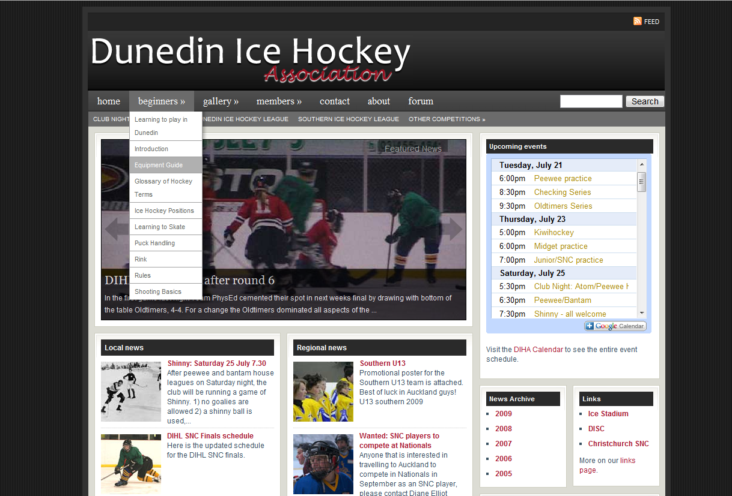

Slide 6

Dropdown menus in WordPress
Miriam Schwab of wordpressgarage.com posted about a dropdown menu plugin
Two choices
  Whine about it
  Make my own
https://geek.hellyer.kiwi/ htttps://twitter.com/ryanhellyer/

Slide 7
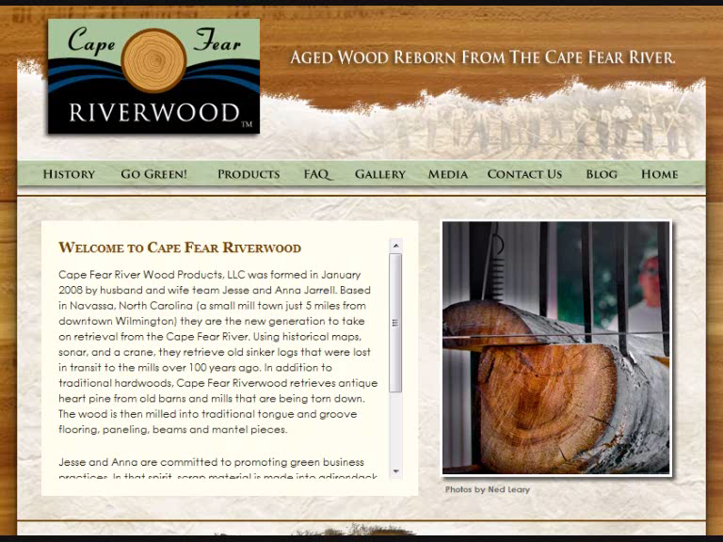
Suckerfish Dropdown Menu plugin
Released in Jan. 2008
Support questions!
1000+ comments in one month!

Slide 8
Needed a better way to help plugin users
  Users needed to change menu styling
  Created a forum to help sort advice for others
  Still too many questions
  Needed to reduce support requests
  Solution?
    Created CSS generator

Slide 9
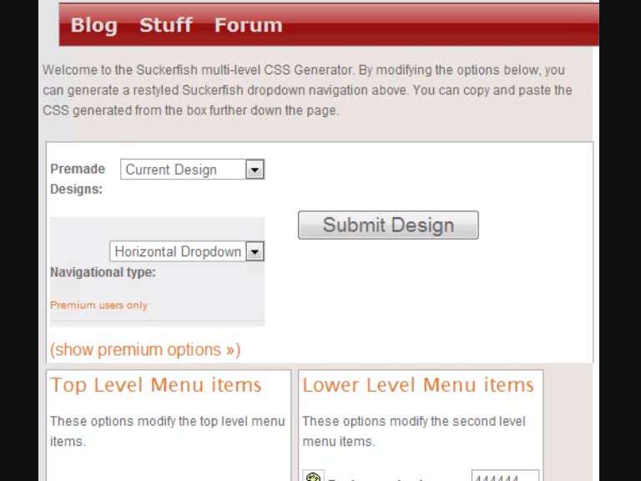
CSS generator
  Allowed me to charge for premium access
  Almost all services free
  Support requests plummeted!!!
  Paid service

Slide 10

https://geek.hellyer.kiwi/ htttps://twitter.com/ryanhellyer/

Slide 11

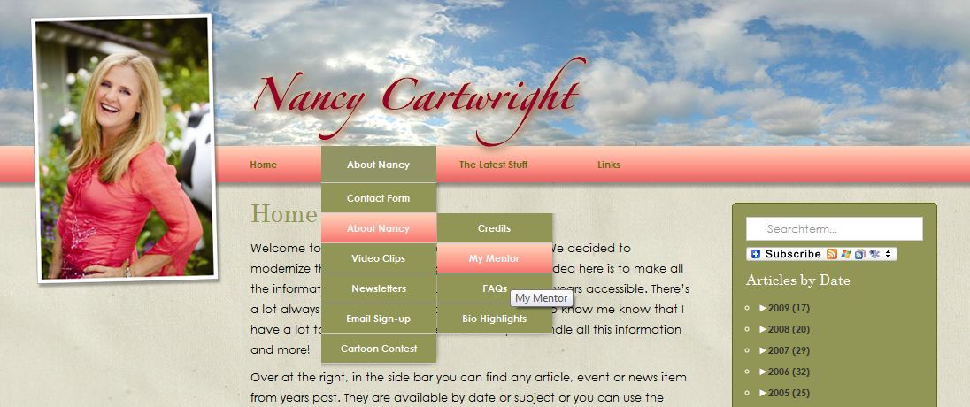
Menu plugin users …
John McCain
Nancy Cartwright (Bart Simpson)

Slide 12
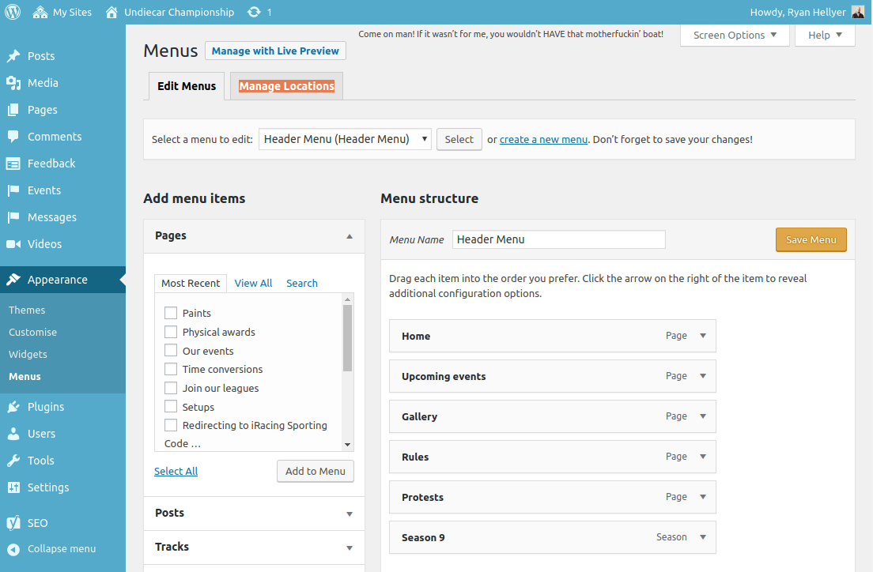

Slide 13
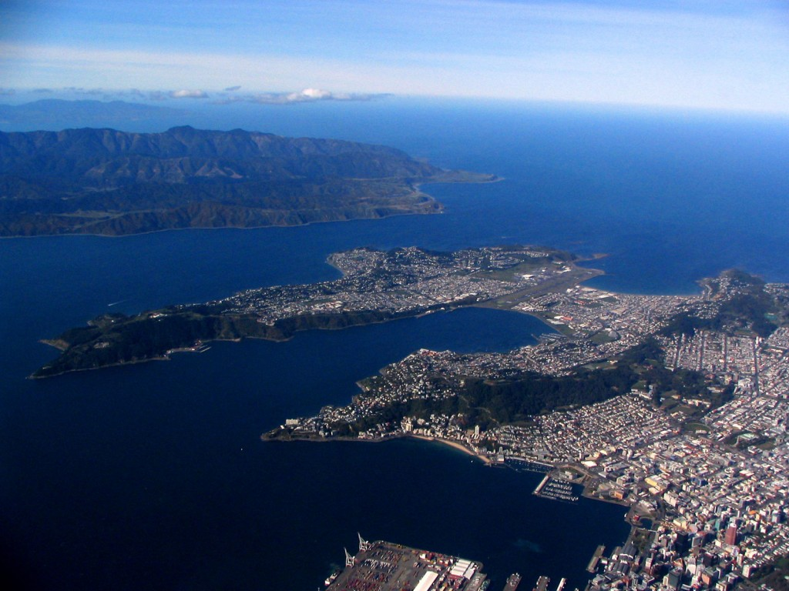
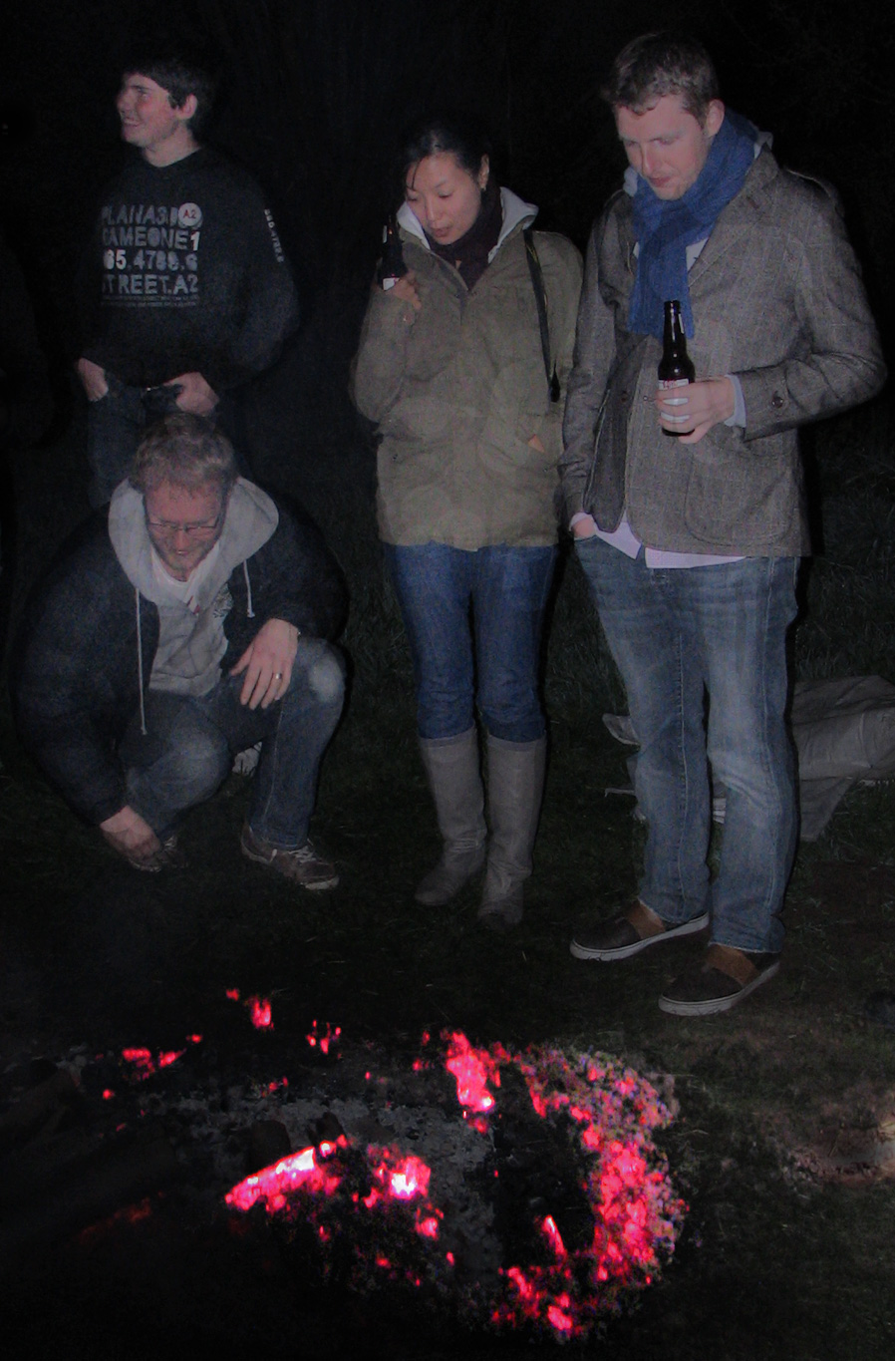
Community - WordCamp New Zealand

Slide 14
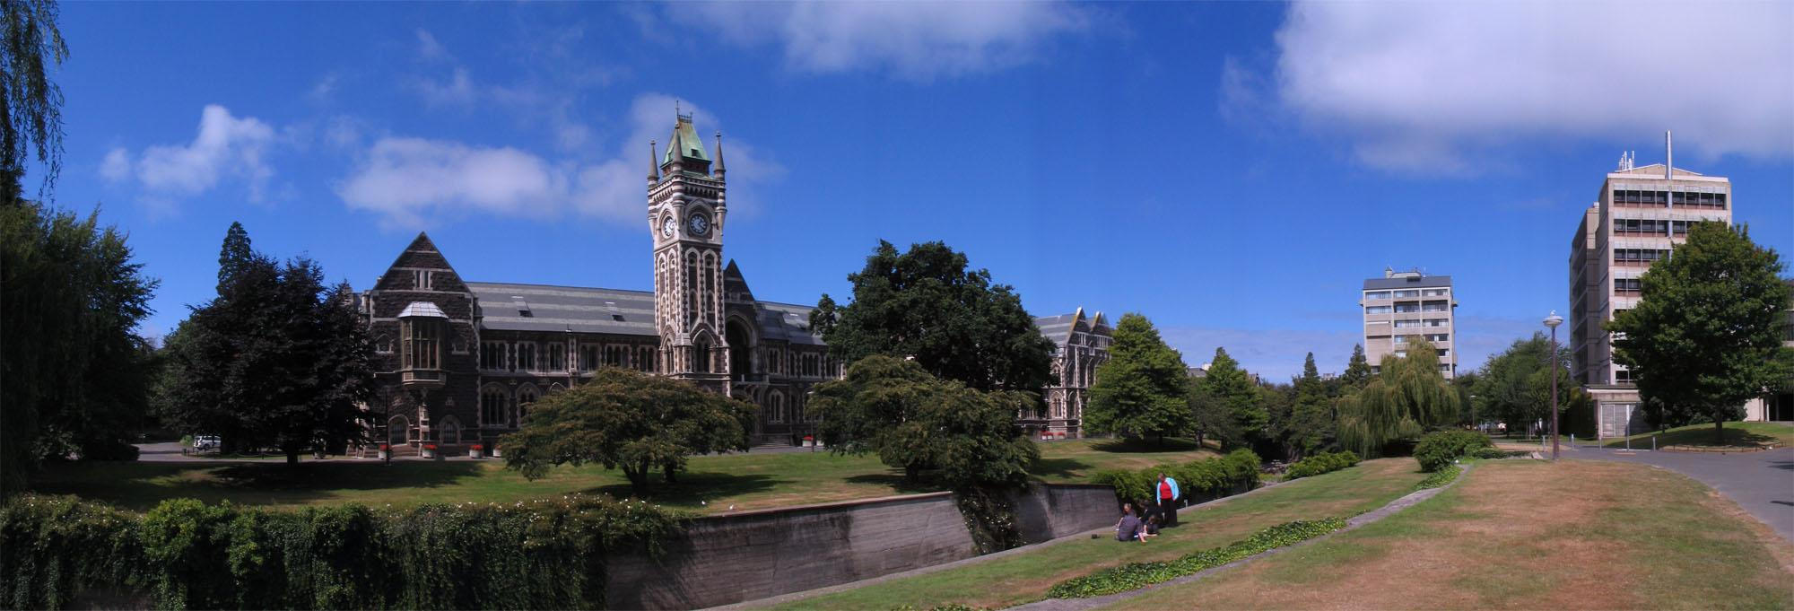
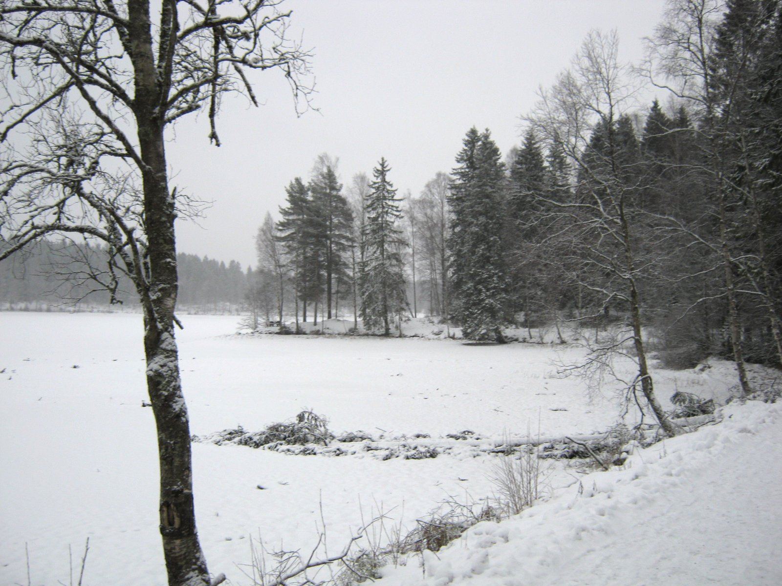
New Zealand -> Norway

Slide 15
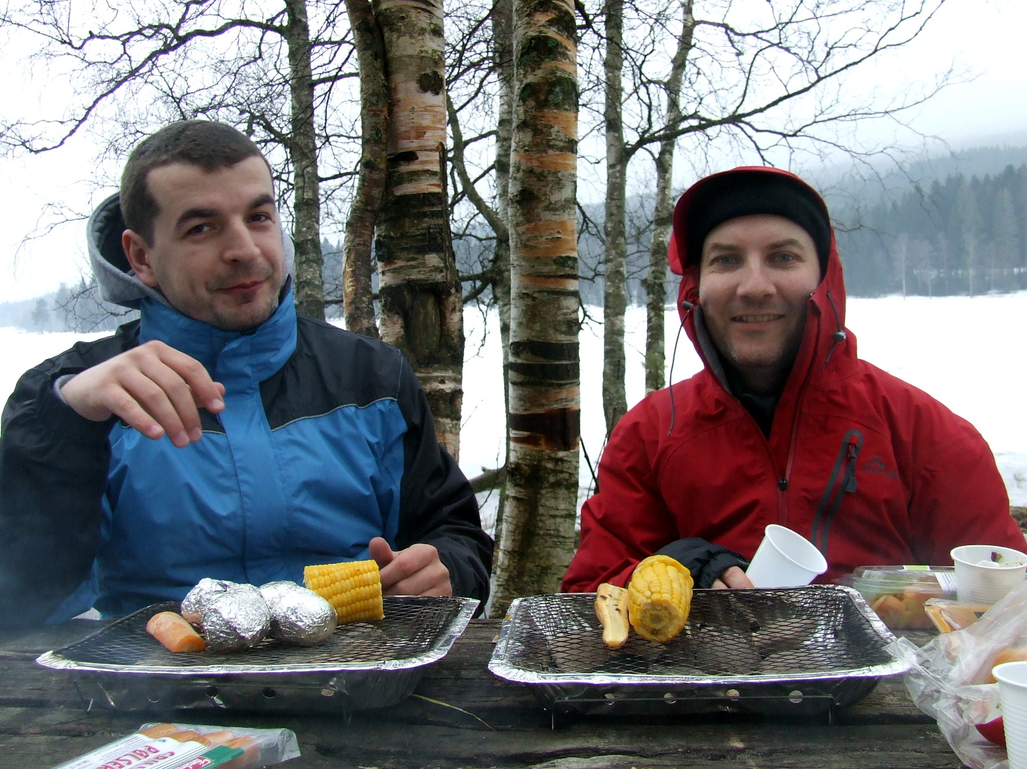

Slide 16
All the WordCamp’s!
  WordCamp Norway
  WordCamp Romania
  WordCamp Lisboa
  WordCamp Oslo
  WordCamp Transylvania
… leads to opportunities

Slide 17
Zero profit plugins
  Nice for community
  Huge support required
  Solution = simple plugins

Slide 18

Norwegian government

Slide 19
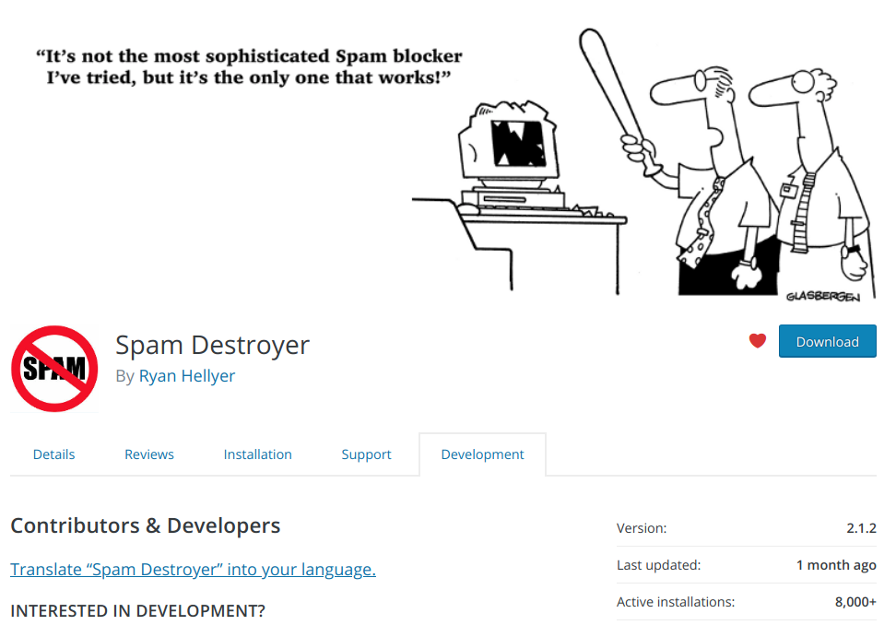

Slide 20
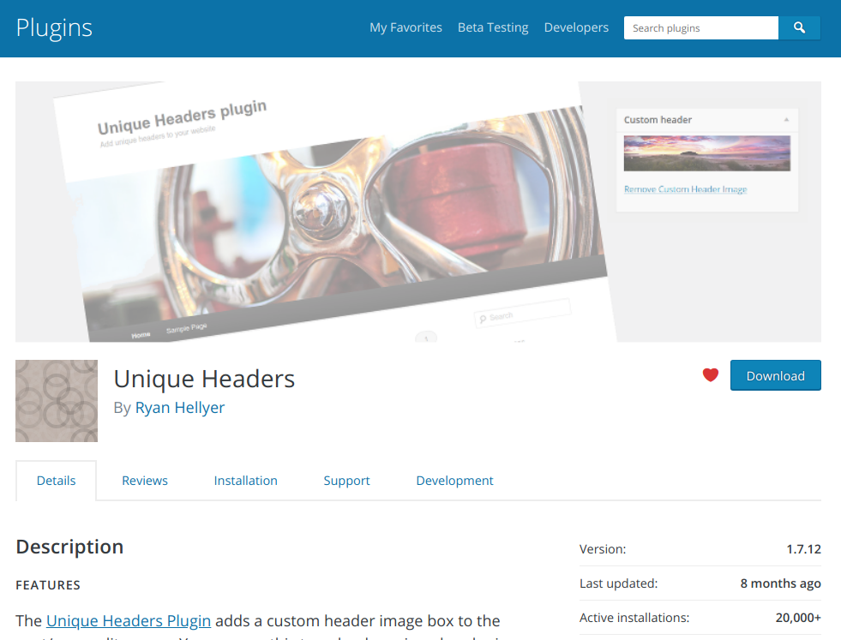

Slide 21
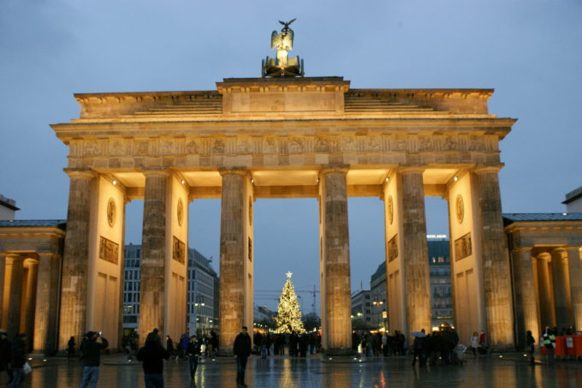

Slide 22
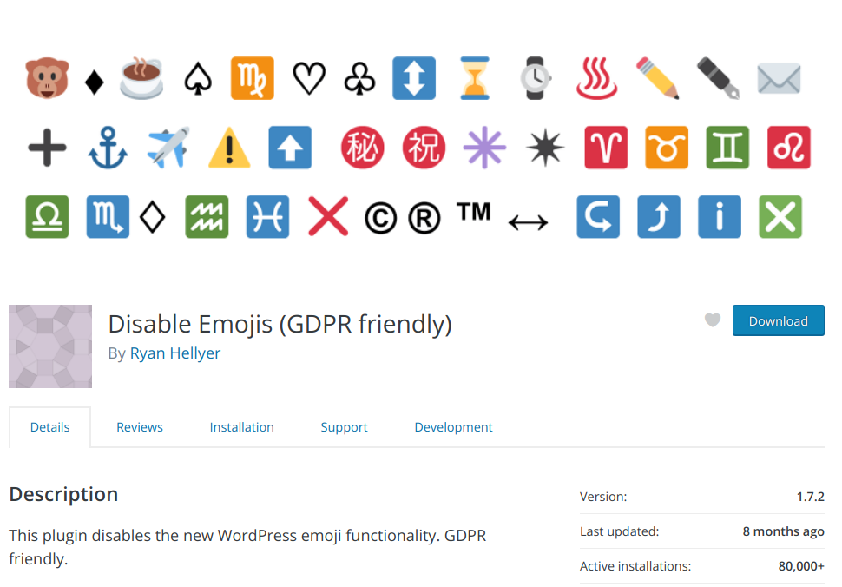

Slide 23

Back to the future!
Now working for
Miriam Schwab
https://www.strattic.com/

