Slide 1

Bytes and Minds:
Navigating Mental Health in the Tech World
https://geek.hellyer.kiwi/
ryanhellyer@gmail.com @ryanhellyer
Notes:
First non-tech or non-science talk at a conference.

Slide 2


Trigger warning
Suicide and other emotional topics
Notes:
Creating space to open up the conversation

Slide 3


Who am I?
Notes:
This is my journey

Slide 4
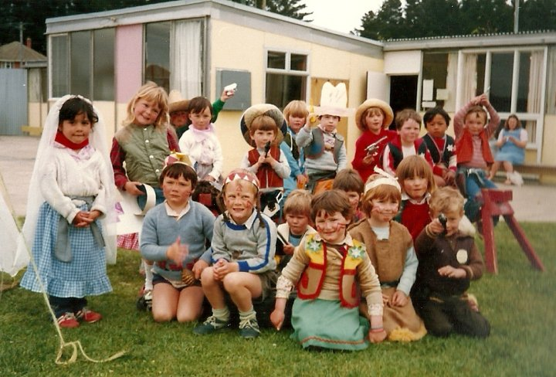

Slide 5

February 12th 1985
Notes:
Just mention February, skip over the date to avoid explaining too much here

Slide 6
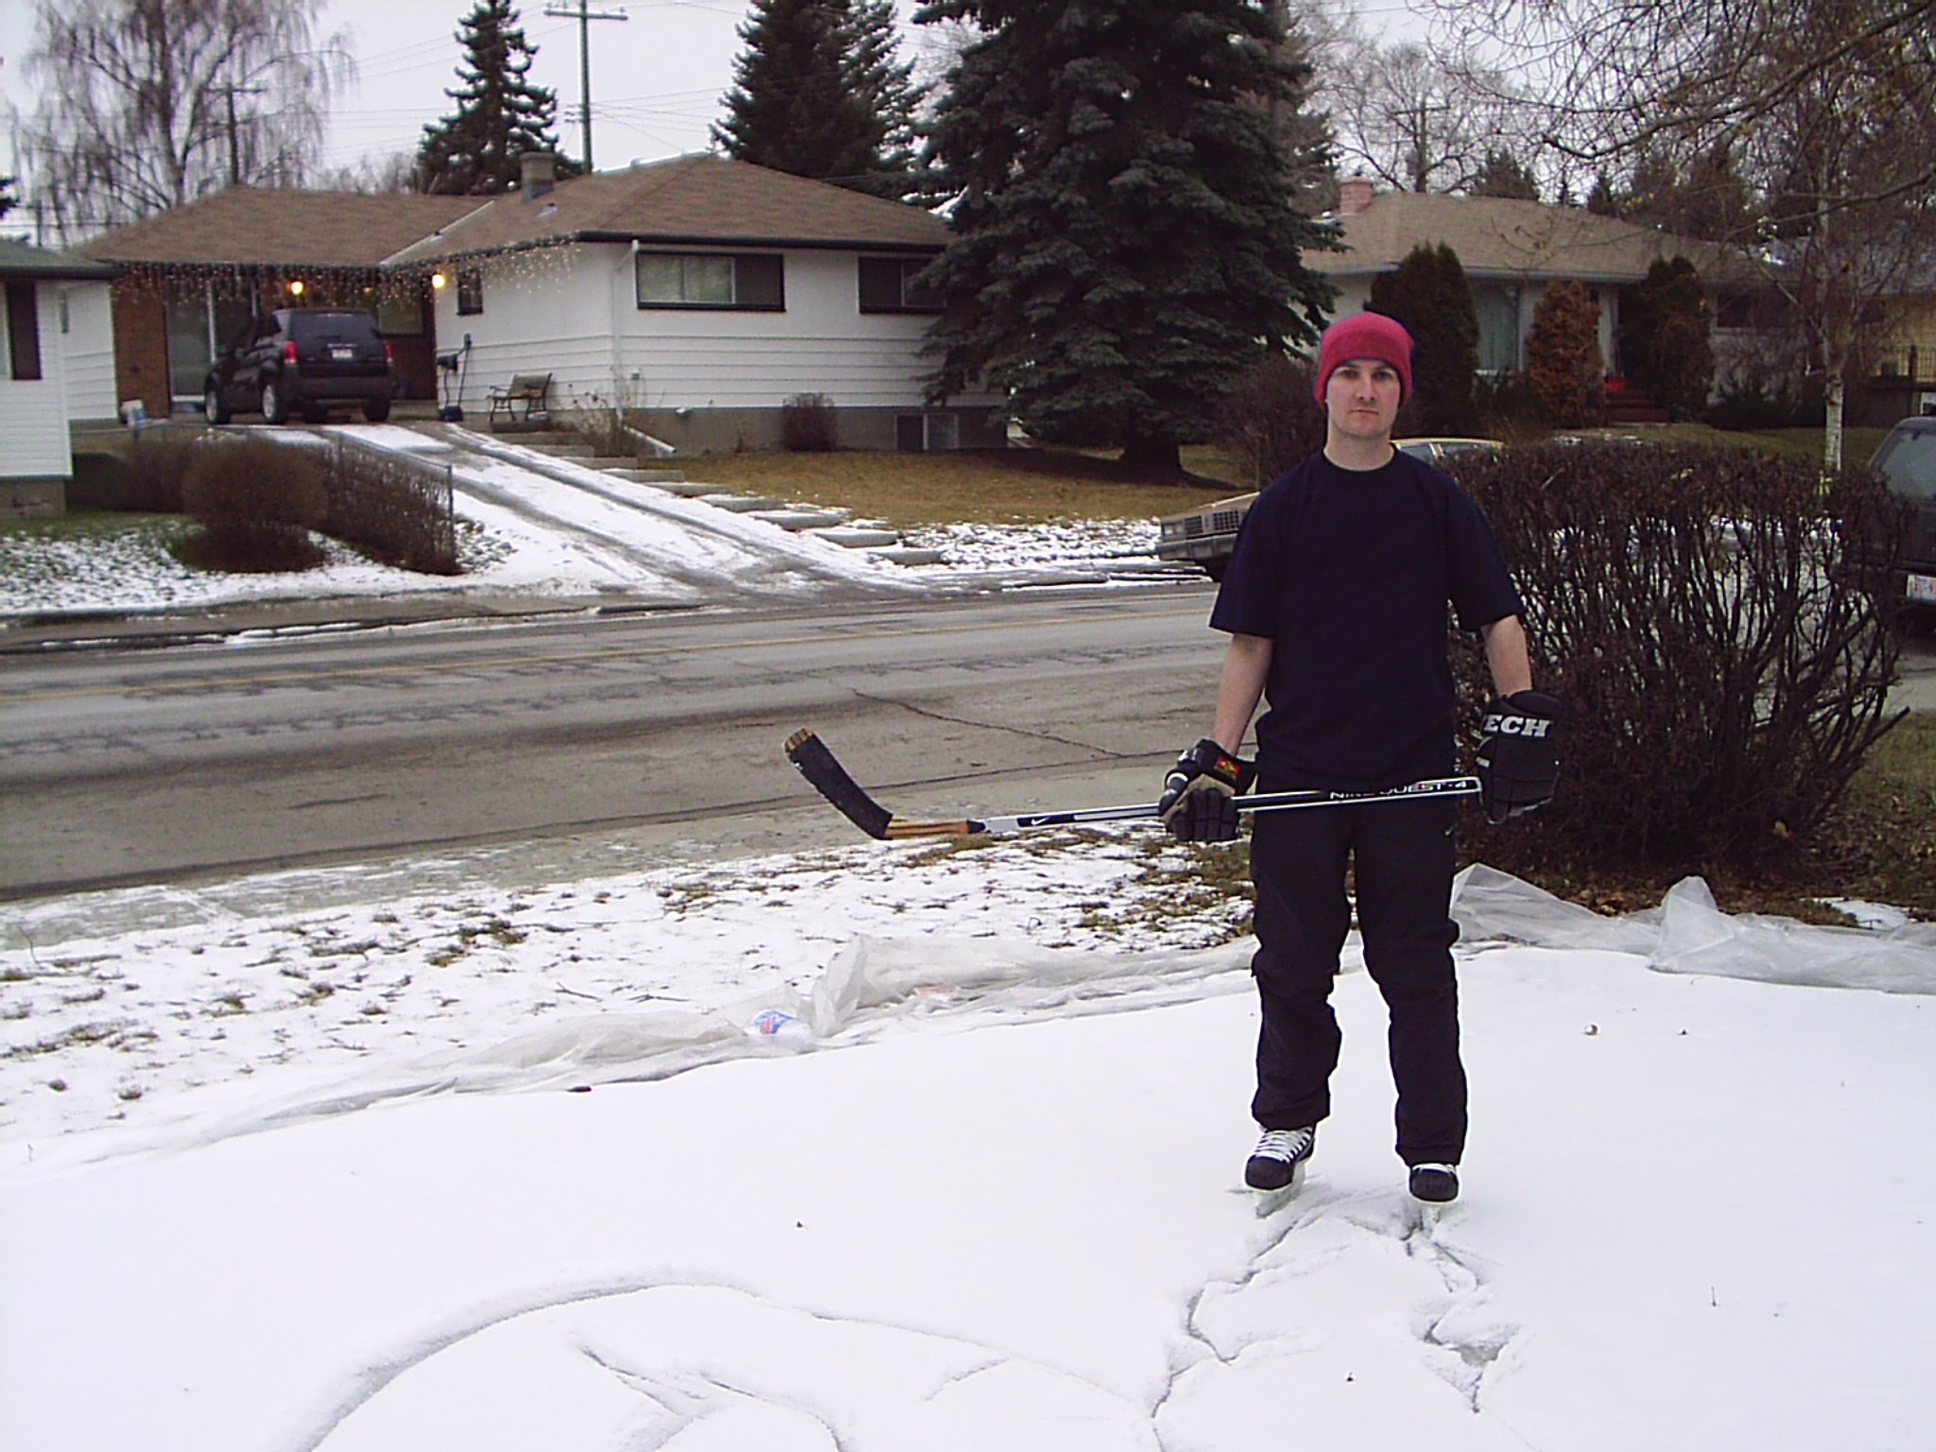
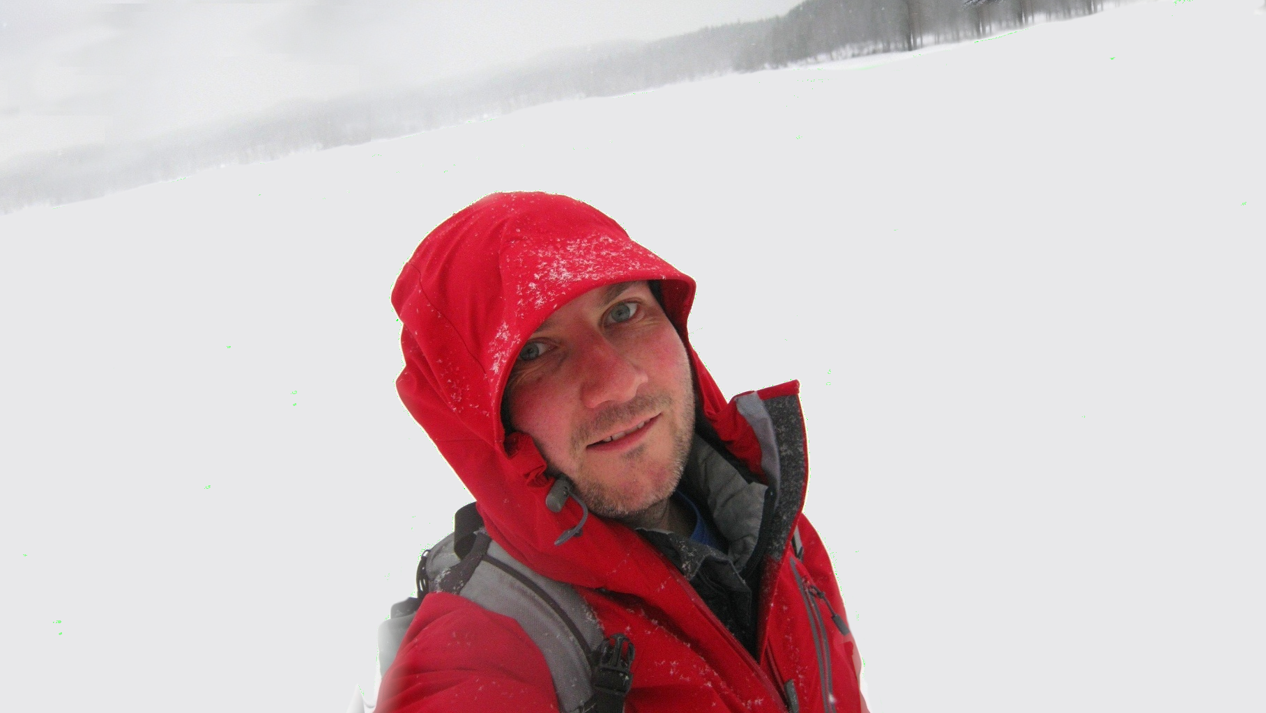
Canada
Norway

Slide 7
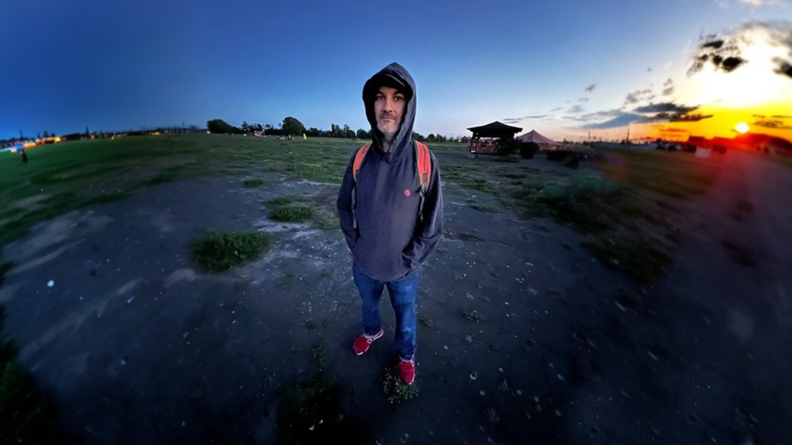
Berlin

Slide 8
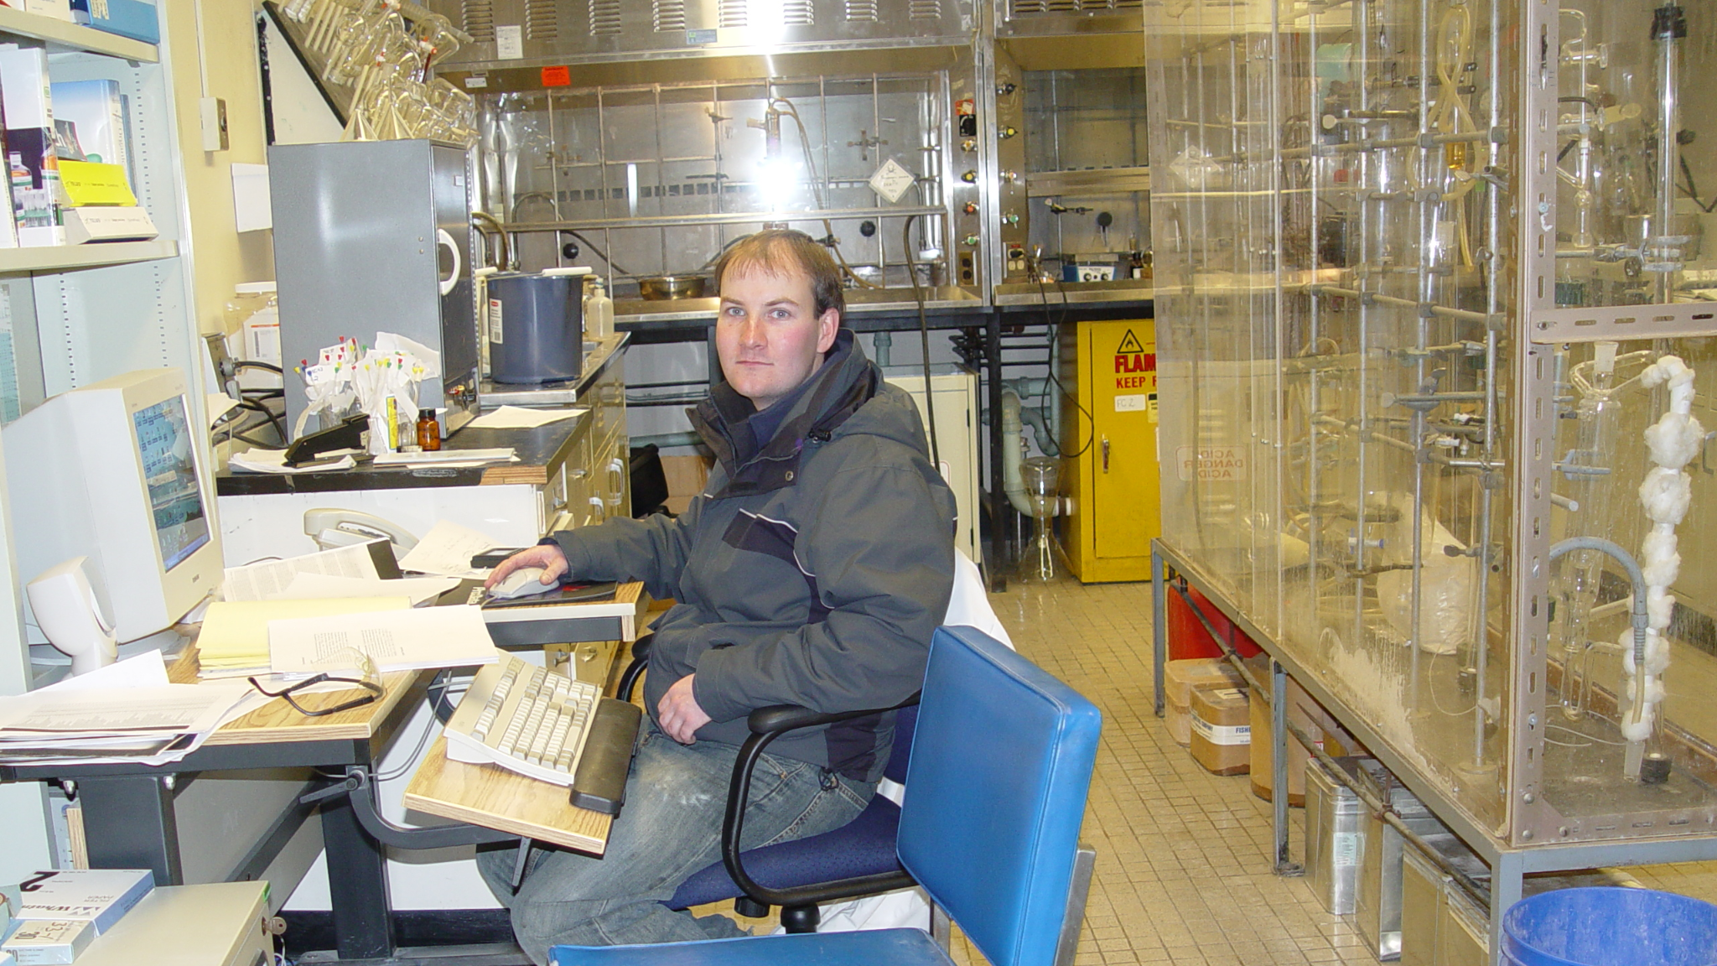

Became a chemist

Slide 9


Slide 10


Depression
Felt happy until age 5
Almost daily nightmares
8% to 15% depression rate
(high income countries)

Slide 11

Anger
Started ~2017
Irrational, so suppressed it
Headache for three months
(Coke Zero, 1 L+)
Why angry?

Slide 12
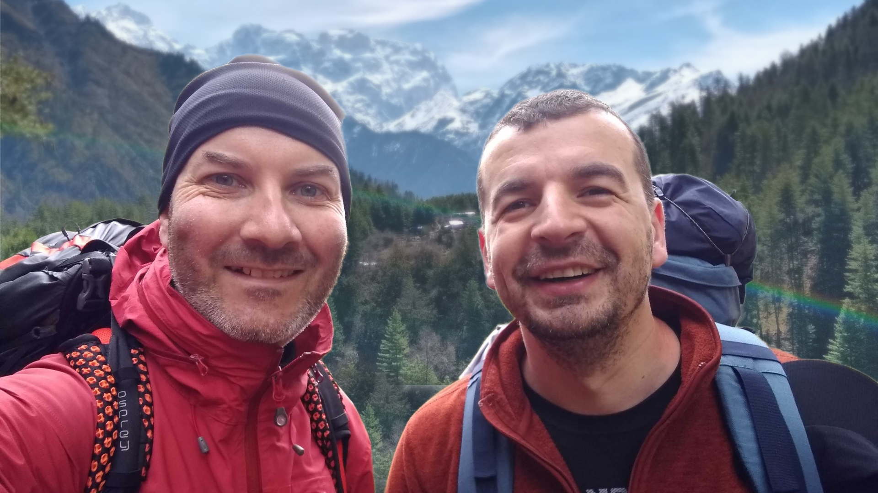
2019

Slide 13



WP plugin
Friends and family
Scheduled blog posts
Authorities
Connected to hardware
/wp-content/plugins/the-end/

Slide 14
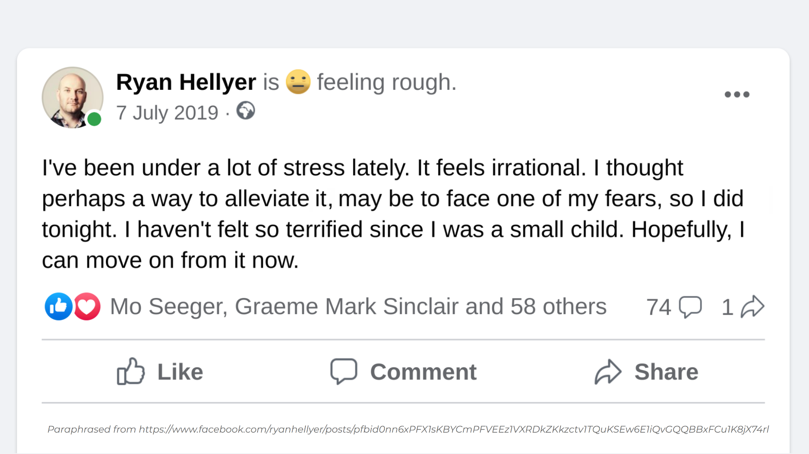

Slide 15

Response
Messages from 9 people
Similar problems
Talked to friends?
Tried therapy?
“You’re different”
6 WordPress devs

Slide 16

Medical help
New doctor
Zero tests
Prescribed St Johns Wort
(Sint-janskruid)
Referred for …

Slide 17


Psychotherapy
Likely stems from parents
Meditation / mind body exercises
Emotional release
One year in - felt better, but still angry
Two years in: no further improvement
(still “likely stems from parents”)
Psilocybin therapy?
(overwhelming urge)

Slide 18
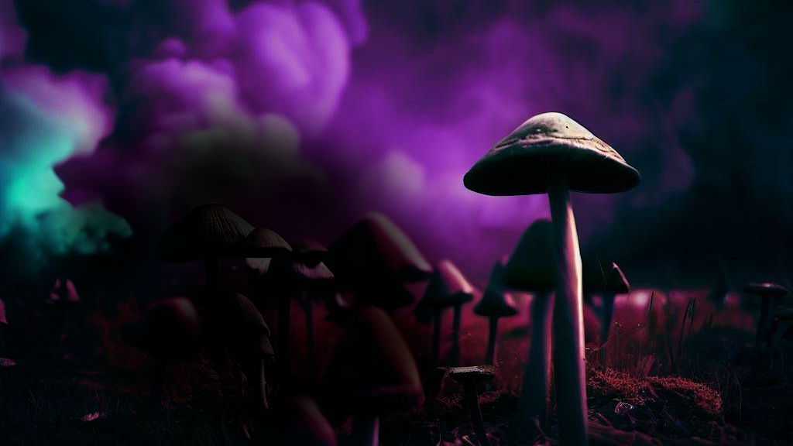
Psilocybin therapy
Magic mushrooms / truffles
Imperial College London study
https://www.nejm.org/doi/full/10.1056/NEJMoa2032994
“I want to know why I’m depressed.
I just don’t know why. I wish I could know. I wish I could understand.”
Dr Rosalind Watts quoting a study participant - https://www.youtube.com/watch?v=WtU3FP-ZLGw

Slide 19
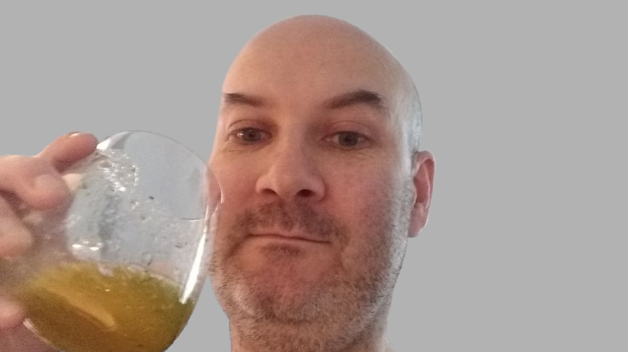
February 12th 2021

Slide 20


Slide 21


Slide 22
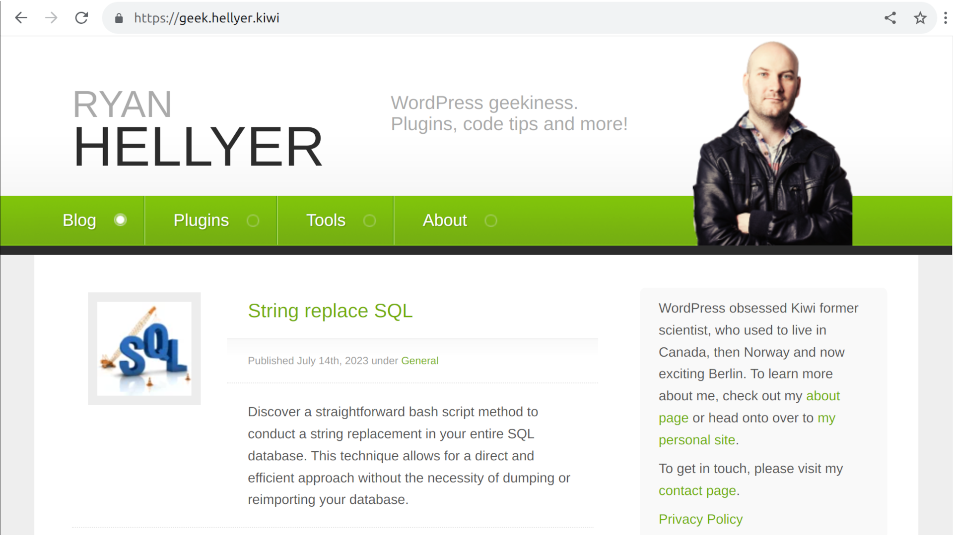

Slide 23


Slide 24
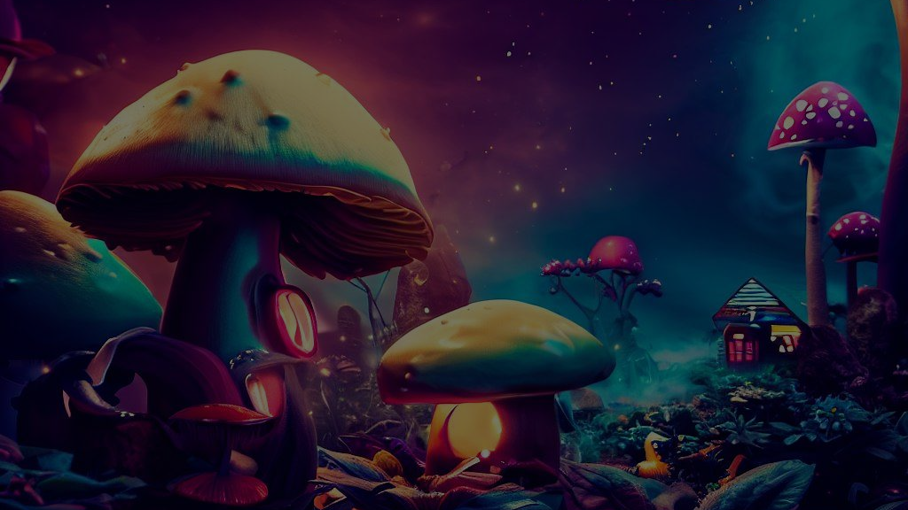
“You were correct. I have a fundamental attachment to my parents.”
“You were correct. I have a fundamental attachment to my parents.”
“You were correct. I have a fundamental attachment to my parents.”
“You were correct. I have a fundamental attachment to my parents.”

Slide 25


Slide 26
Car crash listed: February 12th 1985
Psilocybin trip: February 12th 2021
Notes:
Just mention February, skip over the date to avoid explaining too much here

Slide 27


After effects
Happiest since 5 years old
Emotion sources > solutions
No nightmares
Crying is good
Resting heart rate ~95 BPM
(for three months)

Slide 28

Conclusion?
Devs are not robots
We hide things from ourselves
Emotions are complicated
Seek help / get therapy
You are not alone
Be careful with drugs
Notes:
This is my journey, everyones experiences are different

Slide 29
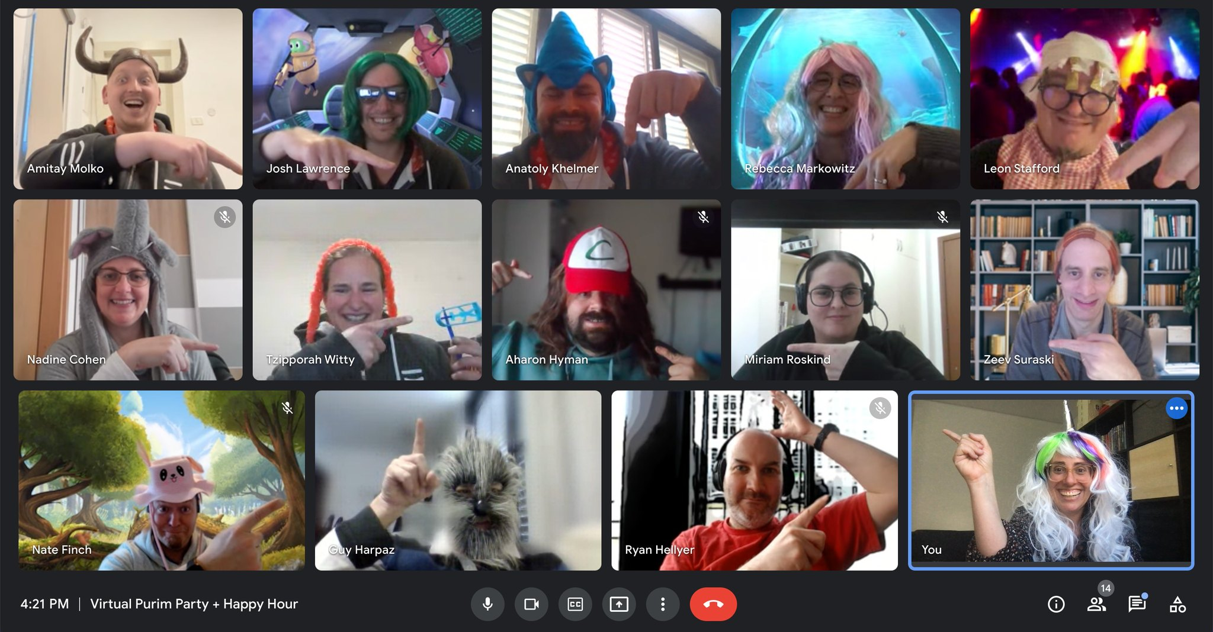
Thank you!
Friends
Family
Strattic team

Slide 30

Remote work
"Working alone all day. How do you cope with seeing no one?"

Slide 31


Hiring?
I’m available
PHP/JS developer
WordPress specialist
Team lead
https://geek.hellyer.kiwi/
@ryanhellyer
ryanhellyer@gmail.com

Slide 32
BONUS
SLIDES

Slide 33

Microdosing
Self-blinding citizen science to explore psychedelic microdosing:
https://pubmed.ncbi.nlm.nih.gov/33648632/
“The findings suggest that anecdotal benefits of microdosing can be explained by the placebo effect.”
Video review: https://www.youtube.com/watch?v=ZPumLlvrv0A
Microdosing with psilocybin mushrooms: a double-blind placebo-controlled study:
https://www.nature.com/articles/s41398-022-02039-0
“mushroom material did not present significantly positive impact ... we observed a trend towards impaired performance in some cognitive tasks”

Slide 34
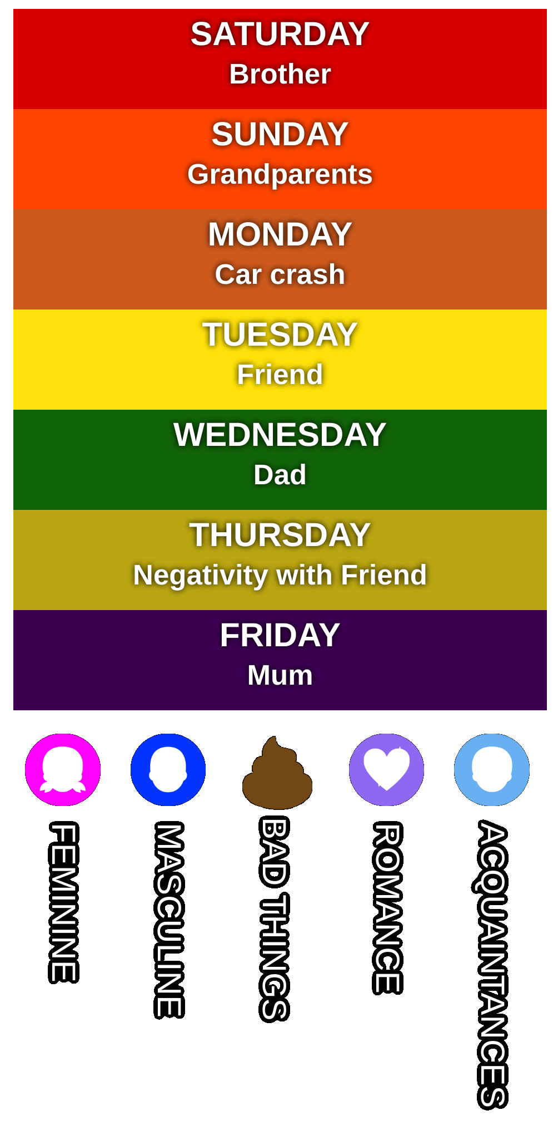
Synesthete
People
Days of the week
Moods
Events

Slide 35

Student loan
No issues with payment
Fear of contacting the tax department about it
Paid in full within two weeks

Slide 36
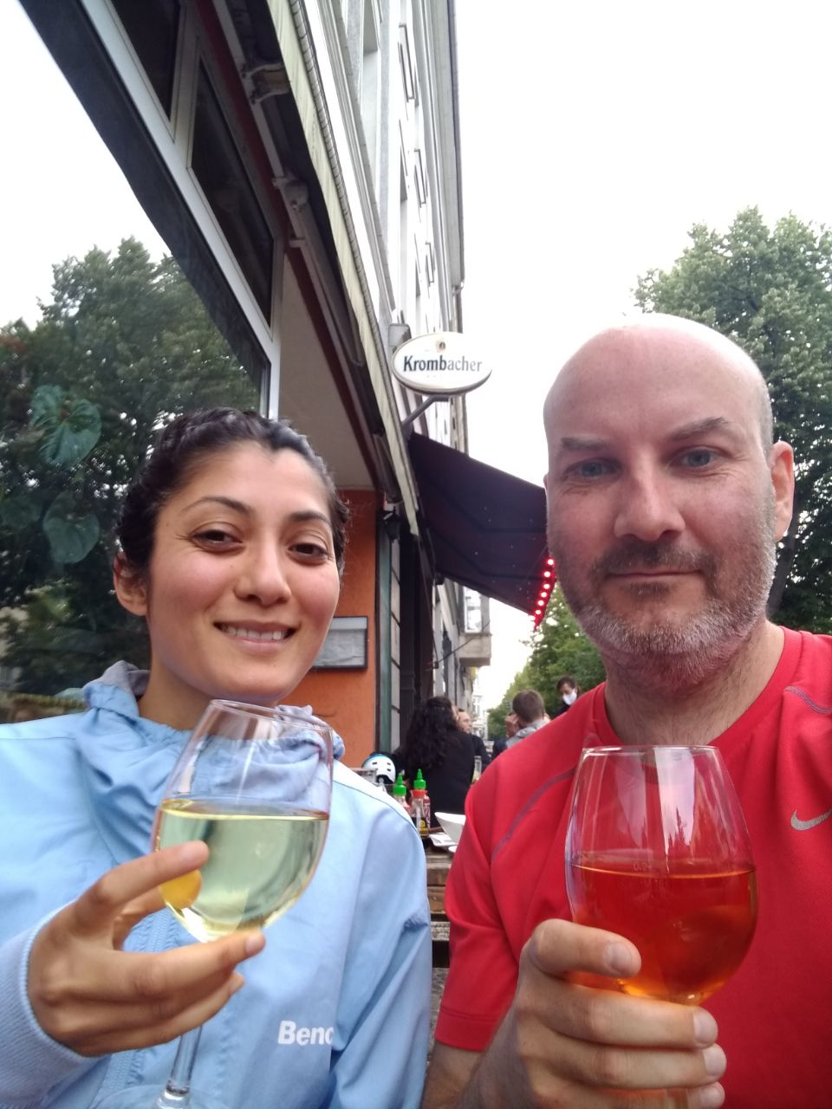
Madhvi

Slide 37

“Must call Skype”

Slide 38


Slide 39


Slide 40
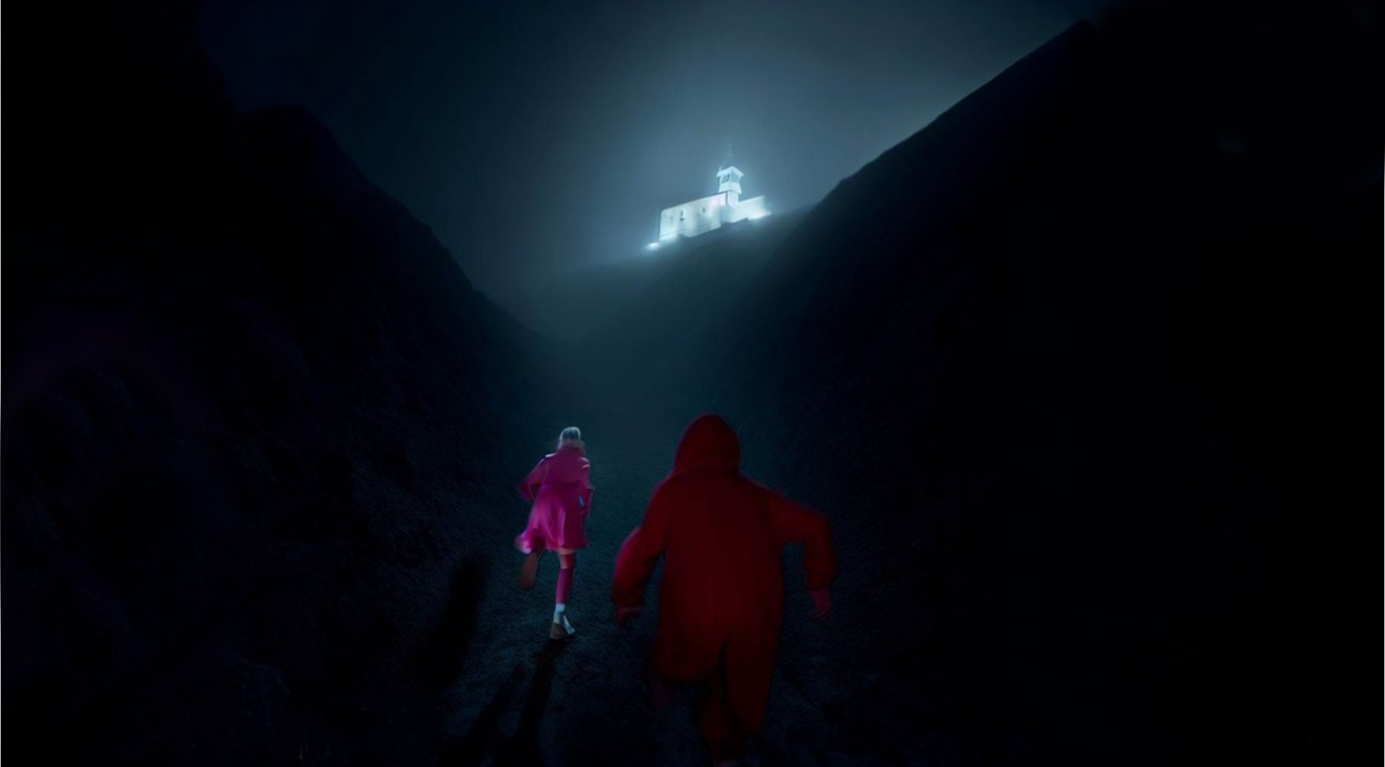

Slide 41


Slide 42

Cannabis?
Therapist approved
Ineffective
Increased anxiety
Don’t code whilst stoned!

